Slide 2
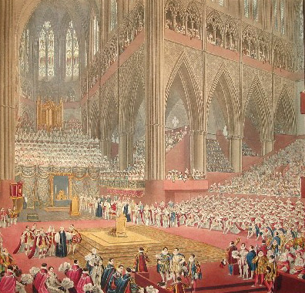
What Is a Coronation?
A coronation is a ceremony where a king or queen is officially given the crown of the country.
It is a ceremony full of pageantry and celebration but it also has a solemn religious side.
It is almost like a marriage ceremony between the monarch and their country.
This is George IV’s coronation in 1821

Slide 3
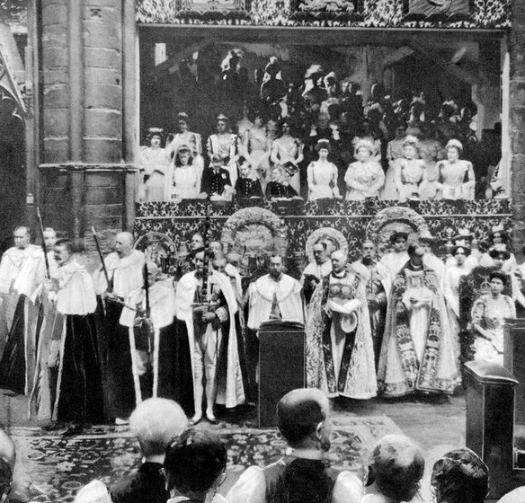
What Is a Coronation?
A new king or queen becomes the monarch at the very second that the previous monarch dies or abdicates (stands down). This is called ascension.
The coronation happens a number of months after ascension. This is because there needs to be time for a period of mourning where the country thinks about the monarch that has died.
A coronation is also a massive event that needs an awful lot of planning so there needs to be plenty of time for the organisation.
The 1911 coronation of George V and Queen Mary, which was the first to be photographed.

Slide 4
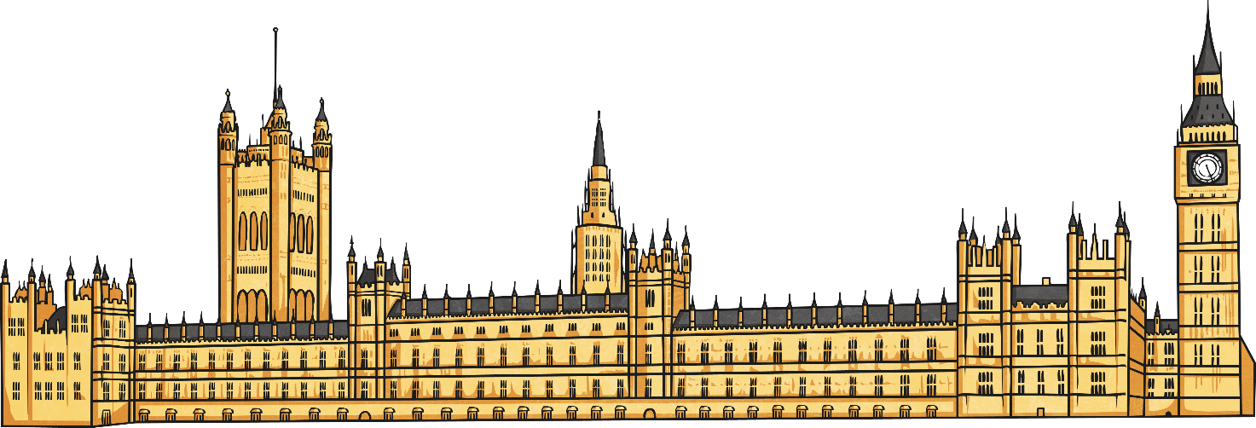
Where Does the Coronation Take Place?
For the past 900 years, the coronation of the British monarch has taken place in Westminster Abbey.
In 1066, Harold II was the first to be crowned there.

Slide 5
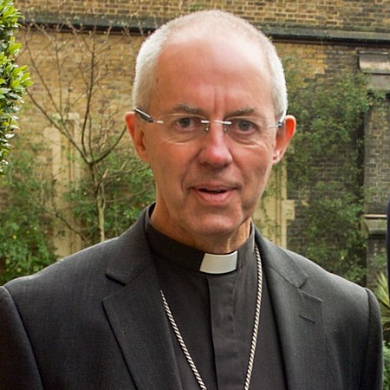
Who Leads the Coronation?
Since 1066, the ceremony has nearly always been done by the Archbishop of Canterbury. This is the leader of the Church of England and this post is currently held by a man called Justin Welby.
Geoffrey Fisher was the Archbishop who led the coronation ceremony when Queen Elizabeth II was crowned.

Slide 6
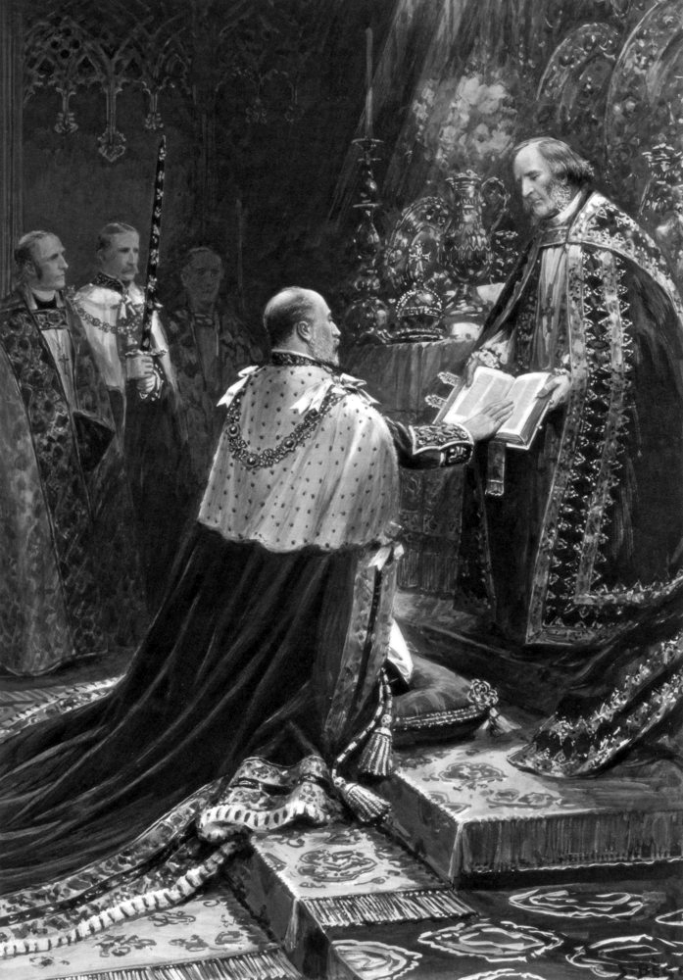
What Happens at the Coronation?
The coronation service for the British monarch has been the same for around 1000 years.
The sovereign (king or queen) makes an important promise called the Coronation Oath.
Then, the sovereign sits in King Edward’s Chair (made in 1300) where he or she is ‘anointed, blessed and consecrated’ by the Archbishop. During this part, holy oil is put on the sovereign’s hands, chest and head.
After the anointing, the sovereign is given the orb and sceptres before having the crown placed on their head. These are known as the Crown Jewels.
This is Edward VII taking the Coronation Oath in 1902.

Slide 7
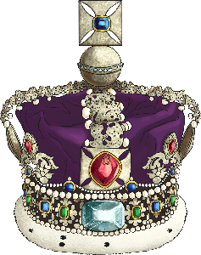
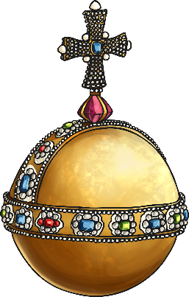
The Crown Jewels
The Crown Jewels are kept in the Tower of London and made up of the orb, sceptres and the crown itself.
The royal crown is a symbol of power and authority, of triumph, victory, legitimacy, honor, and glory, but of resurrection, immortality and righteousness as well.
The monarch has two sceptres – one with a cross to represent their powers as the monarch and the other topped with a dove representing the holy ghost.
The orb represents the world and the cross represents God. Traditionally, the monarch has been God’s representative on earth.

Slide 8
Other Significant Items?
A “coronation spoon” is used to anoint the monarch and has been used at every coronation since 1349. This is one of the only traditional items left from when royal items were destroyed after the defeat of Charles I in 1649.
The Gold State Coach was commissioned in 1760 for the coronation of George III but it took so long to make that it was first used in the coronation of George IV and has been used at every one ever since.
It weighs 4 tonnes and is pulled by eight horses. Most royals who ride in it have reportedly complained about how uncomfortable it is as it’s not a smooth ride!

Slide 9
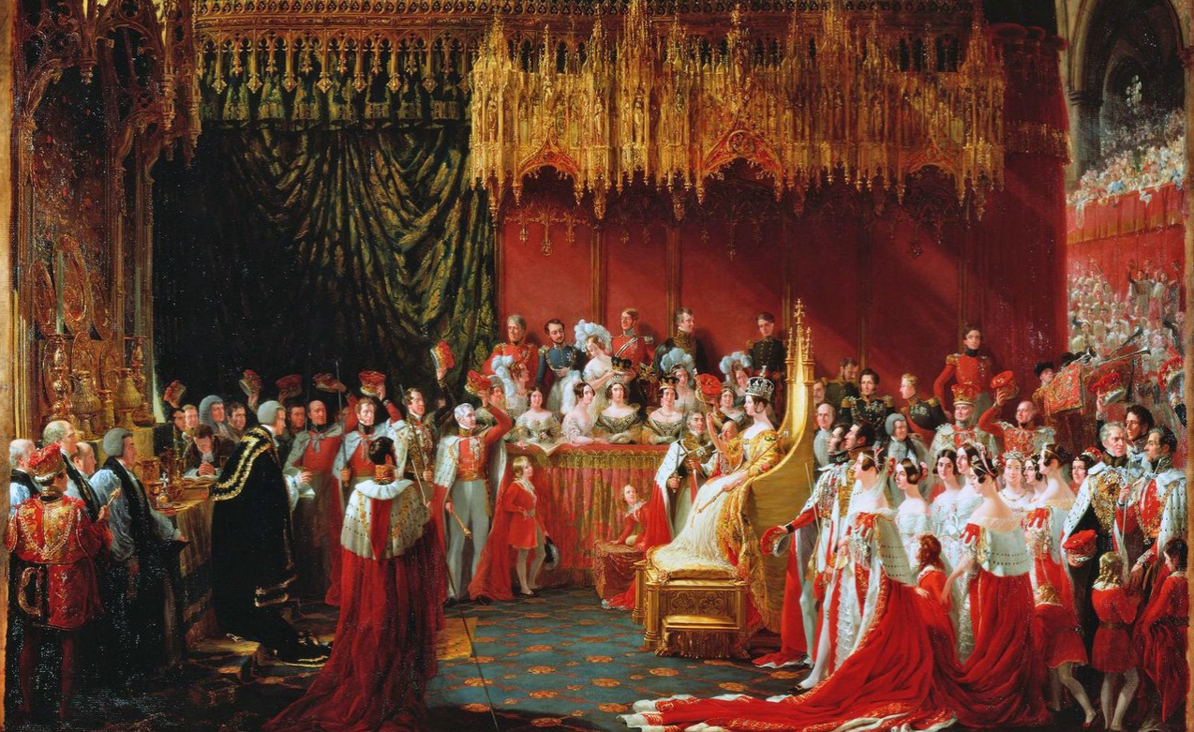
Queen Victoria’s Coronation
The ascension of Queen Victoria was on 20th June 1837 after the death of her uncle, William IV. Her coronation was held almost exactly a year later on the 28th June 1838.
One of the aims was to open it up to a wider public and, thanks to the railways, an estimated 400 000 people joined the people of London. Not only did they get to see the spectacle of two processions where Victoria travelled in the Gold State Coach but also got to visit the four-day long fair held in Hyde Park.
Queen Victoria’s coronation is also known for the amount of mistakes and accidents in the five-hour long ceremony.

Slide 10
Queen Victoria’s Coronation
as seen by Sir George Hayter

Slide 11
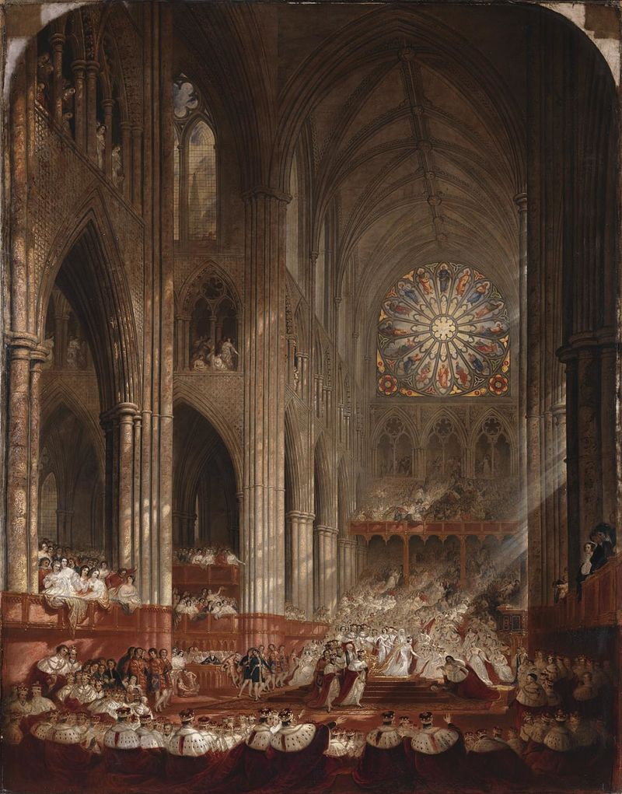
Queen Victoria’s Coronation
as seen by Sir George Hayter

Slide 12
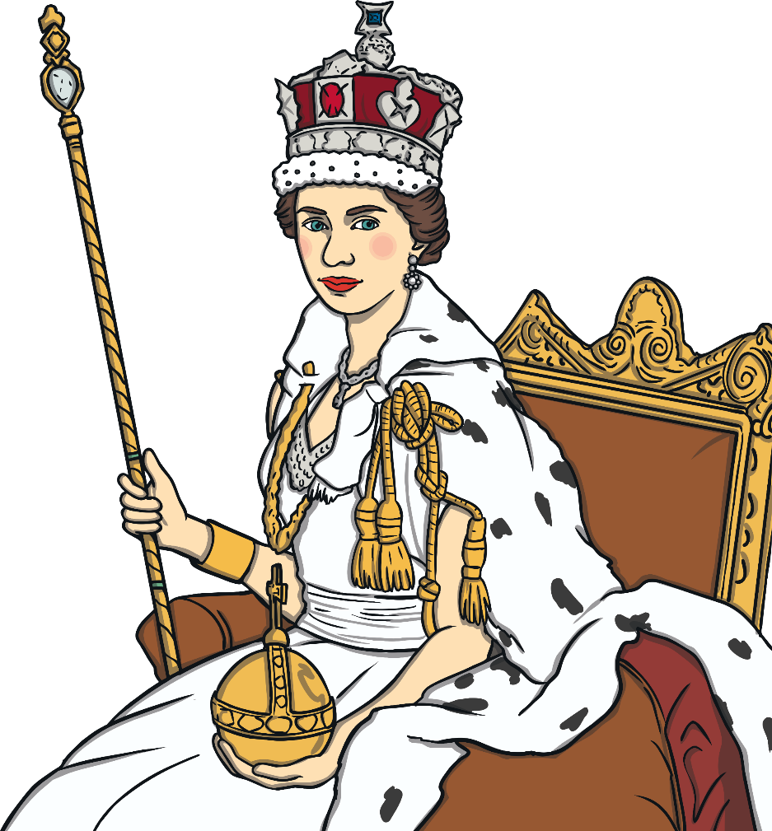
Queen Elizabeth II’s Coronation
The ascension of Queen Elizabeth II was on 6th February 1952 after the death of her father, George VI. Her coronation was not until 2nd June 1953. Queen Elizabeth II was 25 years old.
The exciting thing about this coronation was that, with television being new, it was the first coronation to be televised. Many people bought their first television just to watch it. Why not find some clips on the Internet and see it for yourself?
The ceremony lasted for three hours and was attended by more than 8000 guests.

Slide 13
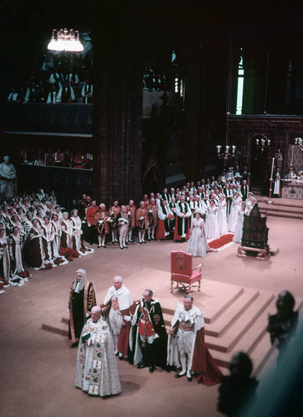
Queen Elizabeth II’s Coronation Oath
The Coronation Oath has changed a little bit over the years but, just like the monarch before her, Queen Elizabeth II took the Coronation Oath:
The Archbishop: Madam, is your Majesty willing to take the Oath?
The Queen: I am willing.
The Archbishop: Will you solemnly promise and swear to govern the Peoples of the United Kingdom of Great Britain and Northern Ireland, Canada, Australia, New Zealand, the Union of South Africa, Pakistan, and Ceylon, and of your Possessions and the other Territories to any of them belonging or pertaining, according to their respective laws and customs?
The Queen: I solemnly promise so to do.
The Archbishop: Will you to your power cause Law and Justice, in Mercy, to be executed in all your judgements?
The Queen: I will.
The Archbishop: Will you to the utmost of your power maintain the Laws of God and the true profession of the Gospel? Will you to the utmost of your power maintain in the United Kingdom the Protestant Reformed Religion established by law? Will you maintain and preserve inviolably the settlement of the Church of England, and the doctrine, worship, discipline, and government thereof, as by law established in England? And will you preserve unto the Bishops and Clergy of England, and to the Churches there committed to their charge, all such rights and privileges, as by law do or shall appertain to them or any of them?
The Queen: I will.

Slide 14
Coronation Facts
The coronation service was created for the coronation of King Edgar in 973.
Edward V and Edward VIII never had coronations as they weren’t on the throne long enough for them to happen.
George VI’s coronation, in 1937, was broadcast by the BBC on the radio.
In the fictional history of the street in the TV programme, Coronation Street was built in 1902 in honour of the coronation of King Edward VII.
Coronation chicken was invented for the banquet of Queen Elizabeth II’s coronation.
The coronation anthem ‘Zadok the Priest’, written by Handel, has been performed since 1727 at every coronation.

Slide 15
Why Not Try…
watching footage of Queen Elizabeth II’s coronation?
listening to the music ‘Zadok the Priest’ and see if you recognise it?
finding out more about the coronations of other monarchs?

