Slide 1





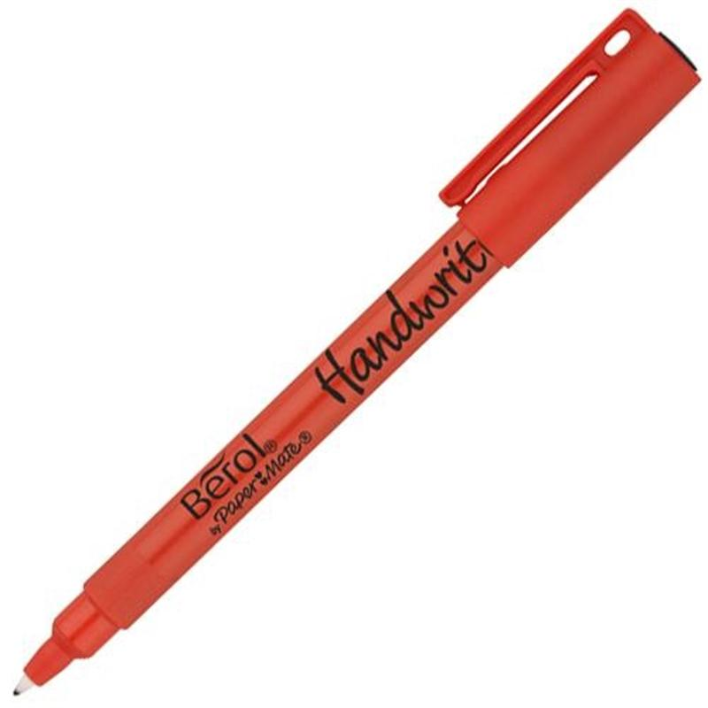
Weekly Newsletter – 12th December 2025
We have had a fantastic week with so much going on. We have had nearly all of the Christmas performances. The Reception Class wowed us with their ‘Wiggily Nativity’ and the KS1 children were amazing with their ‘Big Nativity’. Both performances highlighted how talented the Mill Lane children are. On Thursday the children had a fantastic time at the panto and today the Nursery performed their little nativity which was lovely. One more week to go before the holidays and a well-deserved rest for all!
Stars of the Week
A big well done to all the children in the KS2 choir who performed brilliantly at the Forget Me Knot club on Monday. It was very much appreciated by everyone there.
This week our stars are:
Y1: Finn Koston, Arthur Moseley
Y2: Tommy Walters, Oliver Boyle, Alfie Brooker
Y3: Leo Lofty, Freya Christensen, Ruby Rae Cain, Robyn Graham Standley
Y4: Jude Parsler, Olivia Jones, Ruby Jones
Y5: Paisley Welch, Molly Turney
Y6: Ashleigh Sabin, Molly Morgan, Jamie Browne, Oliver Bonnar, Esme Gutteridge
Congratulations to these children for achieving their Bonze reading award: Leo Gutteridge (Y2), Myles Tucker (Y2), Kai Sherwood (Y3), Layla Bayly (Y3), Lucy Milne (Y4), Jasper Thomas (Y4), Rex Allison (Y4), Mason Gatial (Y4). A big congratulations to Poppy Rogers ((Y2) who has achieved her Silver Reading award.
This week the following children received their Bronze Values Award: Phoebe Caffyn (Y6), Max Turney (Y3), Grayson Watson (Y3), Finlay Richardson (y3), Austin Steele (Y3), Oscar Williams (Y3), Ruby Rae Cain (Y3), Oscar Harrison (Y3), Layla Bayly (Y3), Grayson Davies (Y1), Charlotte Marsden (Y1).
Congratulations to these children for receiving their gold pencils for improved handwriting: Olivia Jones (Y4), Ruby Jones (Y4), Rory Osborne (Y4), Georgina Bradley (Y4).
Well done to the following children who have achieved their pen licence for consistently great presentation in their work: Maya Casey (Y4), Maisie Jennings (Y4), Ruby Samuels (Y4), Freddie Milne (Y4), Lyla Gutteridge (Y4), Jasper Thomas (Y5), Lucy Milne (Y5)
Congratulations to Molly Morgan & Max Thomas in Year 6 who passed their level 2 cycling proficiency test.

Slide 2
Dates For Your Diary
Sunday 14th December: 3pm Choir sing at St.Andrews Festival of Christmas Trees (Meet at the church at 2.55pm)
Monday 15th December: 9.30am Rock Steady Concert
Wednesday 17th December: Christmas dinner and Christmas jumper day
5.30pm KS2 Christmas concert
Friday 19th December: 1pm Celebration assembly
1.45pm Early closing (no after school club)
Last day of term
Last Week of Term
There is one week to go until the end of term so I thought I would just set out the arrangements for the last week. On Monday there will be a performance at 9.30am for the children who take part in the Rock Steady band lessons. Parents are welcome to come and watch with the rest of the school.
On Wednesday we are having our school Christmas dinner, and the children are allowed to wear Christmas outfits e.g. jumpers, festive clothes on this day. In the evening at 5.30pm the KS2 children will be participating in their carol concert. The children have been practicing songs and learning how to play the handbells. Please could the children return to the school between 5.15pm and 5.25pm.
On Friday we will be having our end of term celebration assembly. This will start at 1pm and parents / carers are welcome to join us. The assembly should finish at 1.45pm and this is when children will need to be collected as the school closes at this time.
We return to school on Tuesday 6th January as Monday 5th is an INSET day. There is no holiday club planned for this day as all staff are in training off site.
All that remains is to wish everyone a lovely Christmas and thank you for your support this term. See you in 2026.

