Slide 1


Mill Lane Community Primary School
KS2 SATs 2026
Information Evening for Parents/Carers
Wednesday 19th November 2025

Slide 2
What are the SATs?
SATs are the Standardised Assessment Tests that are given to children at the end of Key Stage 2.
The SATs take place over four days, starting on Monday 11th May ending on Thursday 14th May.
The SATs papers consist of:
  Grammar, punctuation and spelling (paper 1: GPS) – Monday 11th May
  Grammar, punctuation and spelling (paper 2: Spelling) – Monday 11th May
  Reading – Tuesday 12th May
  Maths (paper 1: Arithmetic) – Wednesday 13th May
  Maths (paper 2: Reasoning) – Wednesday 13th May
  Maths (paper 3: Reasoning) – Thursday 14th May
Writing is assessed using evidence collected throughout Year 6. There is no Year 6 SATs writing test.
The key stage 2 tests will be taken on set dates unless your child is absent, in which case they may be able to take them up to 5 school days afterwards.

Slide 3
When and how the SATs are completed
The tests take place during normal school hours, under exam conditions.
Children are not allowed to talk to each other from the moment the assessments are handed out until they are collected at the end of the test.
After the tests are completed, the papers are sent away to be marked externally.
The results are then sent to the school in July.
Each test lasts no longer than 60 minutes:
  Spelling, punctuation and grammar (paper 1: Grammar/ Punctuation) – 45 minutes
  Spelling, punctuation and grammar (paper 2: Spelling) – 15 minutes
  Reading – 60 minutes
  Maths (paper 1: Arithmetic) – 30 minutes
  Maths (paper 2: Reasoning) – 40 minutes
  Maths (paper 3: Reasoning) – 40 minutes

Slide 4
Specific arrangements for SATs
Children with additional needs (who have similar support as part of day-to-day learning in school) may be allotted specific arrangements, including:
Additional (extra) time;
Tests being opened early to be modified;
An adult to scribe (write) for them;
Using word processors independently;
An adult to read for them (including a translator);
The use of prompts or rest breaks;
Arrangements for children who are ill or injured at the time of the tests.
Pupils with an EHCP are automatically allowed up to 25% additional time (except for the spelling paper, which is not strictly timed). Pupils who use the modified large print or braille versions of the tests are automatically allowed up to 100% additional time.
Notes:
The DfE Key Stage 2 access arrangements guidance (https://www.gov.uk/government/publications/key-stage-2-tests-access-arrangements) gives more details on this, including which arrangements need prior permission.
It should be noted that there are cases when pupils can have access to multiple arrangements (e.g. addition time and a scribe). These are detailed in the above document.
Also note, any pupil can ask for a question to be read to them, though not explained to them. In mathematics, words and numbers may be read but mathematical symbols cannot be read.

Slide 5
The results
Tests are marked externally. Once marked, the tests will be given the following scores:
A raw score (total number of marks achieved for each paper);
A scaled score (see below);
A judgement on if the National Standard has been met.
After marking each test, the external marker will convert the raw score to a scaled score. Even though the tests are made to the same standard each year, the questions must be different. This means the difficulty of the tests may vary. Scaled scores ensures an accurate comparison of performance over time.
Scaled scores range from 80 to 120.
A scaled score of 100 or more shows the pupil is meeting the National Standard.
Notes:
There is no separate test that would indicate a pupil is working above the national standard.
A scaled score of less than 99 would indicate a pupil is working below the national standard.
To have a scaled score, pupils must have a minimum raw score (determined each year). If the pupil does not achieve the minimum raw score, they have not demonstrated sufficient understanding of the KS2 curriculum in the subject.

Slide 6
Grammar, Punctuation and Spelling: Monday 11th May
Grammar, punctuation and spelling consists of two papers.
Paper 1 focuses on all three elements (grammar, punctuation and spelling or GPS). The paper lasts for 45 minutes.
Paper 2 consists of a spelling test only. It should take approximately 15 minutes, although this is not a set amount of time (pupils should be given as much time as they need to complete the test).

Slide 7
Grammar, Punctuation and Spelling: Paper 1 (GPS)
The children will have been working hard with their class teacher on developing and securing their knowledge of the technical vocabulary needed in this test.
This test focuses on:
Grammatical terms/ word classes;
Functions of sentences;
Combining words, phrases and clauses;
Verb forms, tenses and consistency;
Punctuation;
Vocabulary;
Standard English and formality.
This test requires a range of answer types but does not require longer formal answers.
Notes:
The question types include:
Circling
Drawing lines to connect
Multiple choice questions (including ticking tables)
One-word answers
Short answer questions

Slide 8
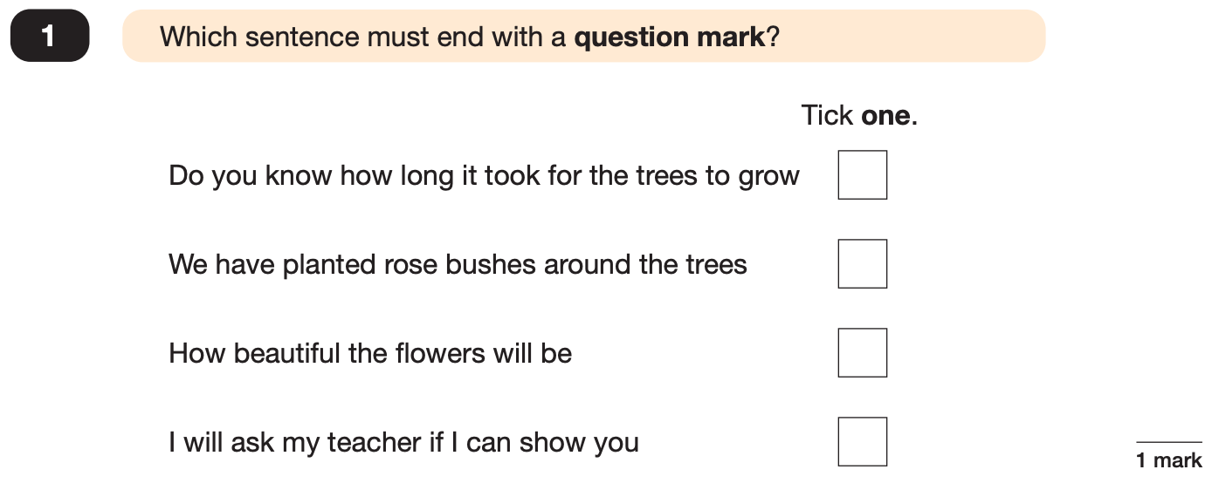
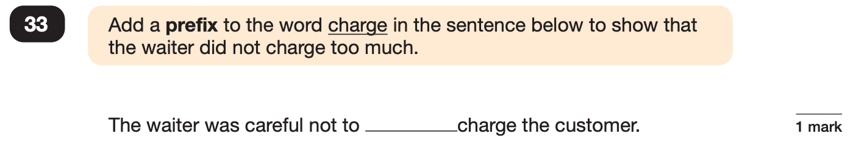
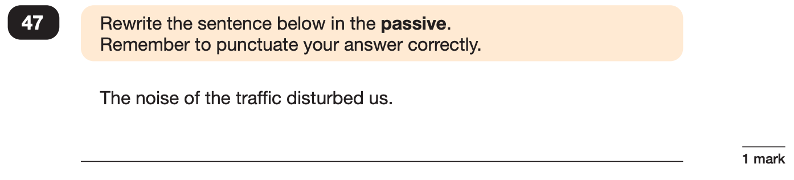
Grammar, Punctuation and Spelling: Paper 1 (GPS)
Example questions:
✓
over
e.g. We were disturbed by the noise of the traffic.
Notes:
Questions are from the 2024 GPS SATs paper.
For question 47 the answer scheme details several correct answers and answers that should not be accepted (e.g. misspellings of verb forms or errors in punctuation or capitalisation.)

Slide 9
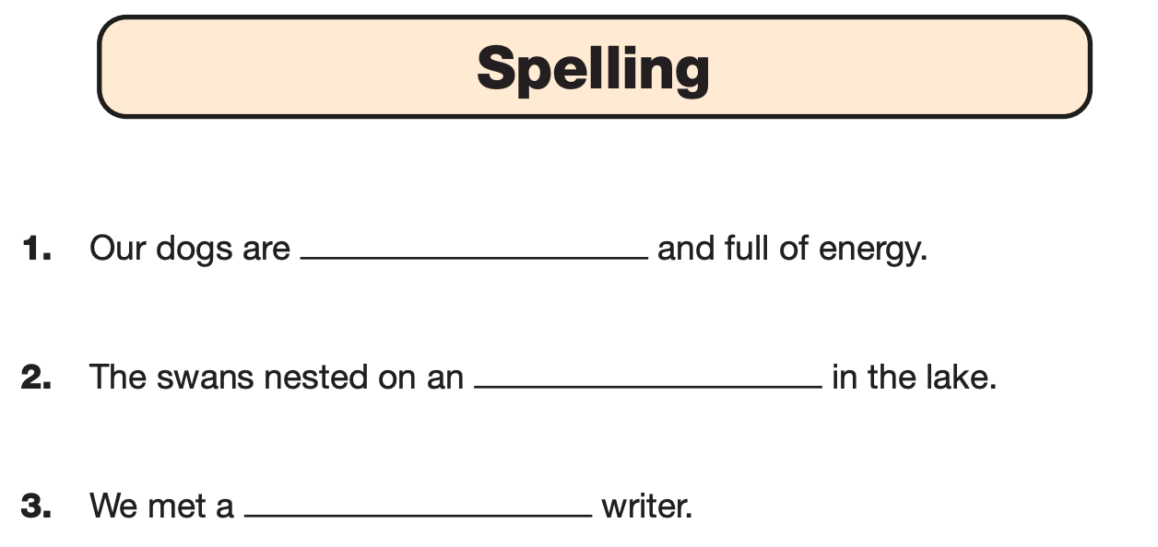
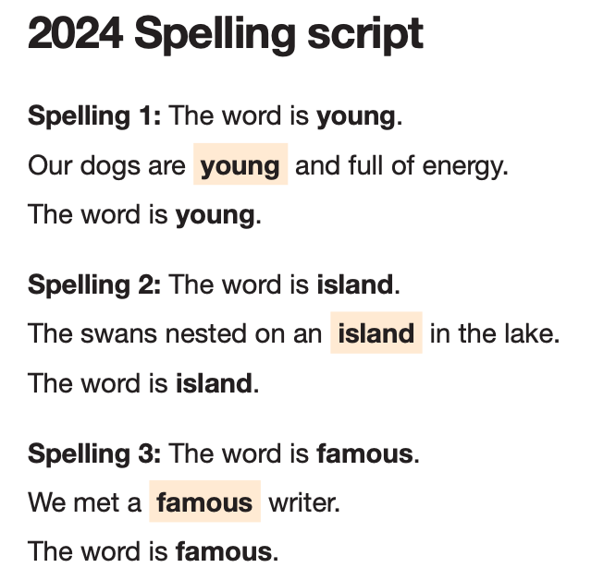
Grammar, Punctuation and Spelling: Paper 2 (spelling)
Paper 2 is a shorter paper that focuses solely on spellings.
Example questions:
Notes:
Questions are from the 2024 Spelling SATs paper.

Slide 10
Reading: Tuesday 12th May
There is one reading test that lasts for 60 minutes.
The test is designed to measure if the children’s comprehension of age-appropriate reading material meets the national standard. There are three different set texts for children to read. These could be any combination of non-fiction, fiction and/ or poetry.
The test covers the following areas (known as Content Domains):
Give/ explain the meaning of words in context;
Retrieve and record information/ identify key details from fiction and non-fiction;
Summarise main ideas from more than one paragraph;
Make inferences from the text/ explain and justify inferences with evidence from the text;
Predict what might happen from details stated and implied;
Identify/ explain how information/ narrative content is related and contributes to meaning as a whole;
Identify/ explain how meaning is enhanced through choice of words and phrases;
Make comparisons within the text.

Slide 11
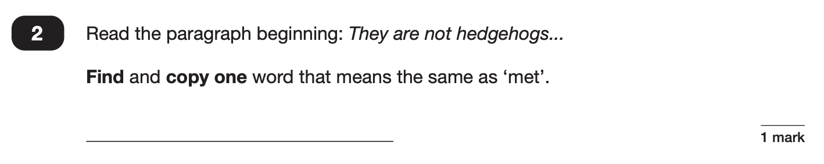
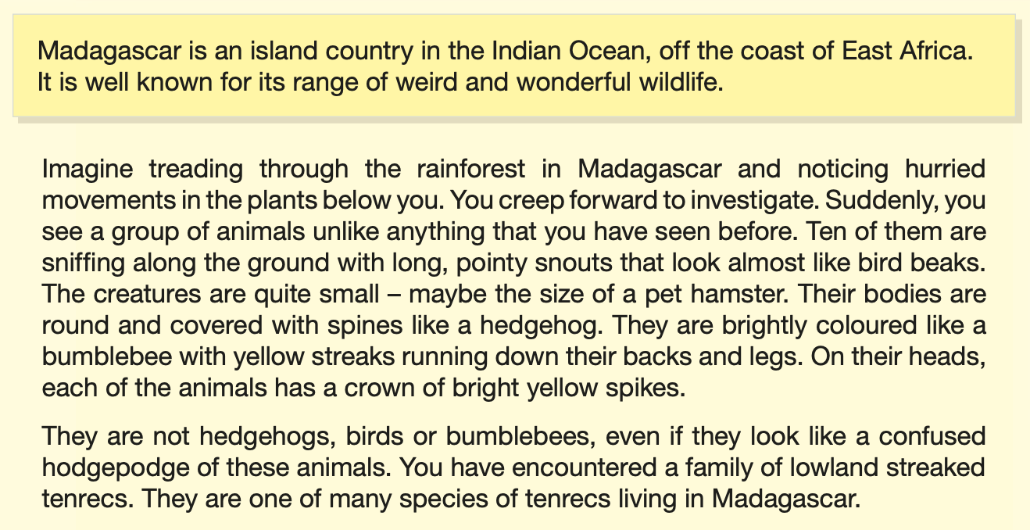
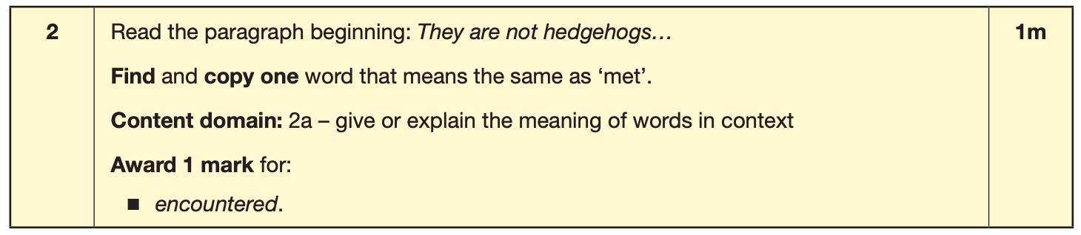
Reading
The reading SATs paper requires a range of answer styles.
Example questions:
Notes:
Questions are from the 2024 Reading SATs paper.
Question styles include:
Multiple choice questions
One-word answers
Short answer questions
Multiple mark (long answer) questions

Slide 12
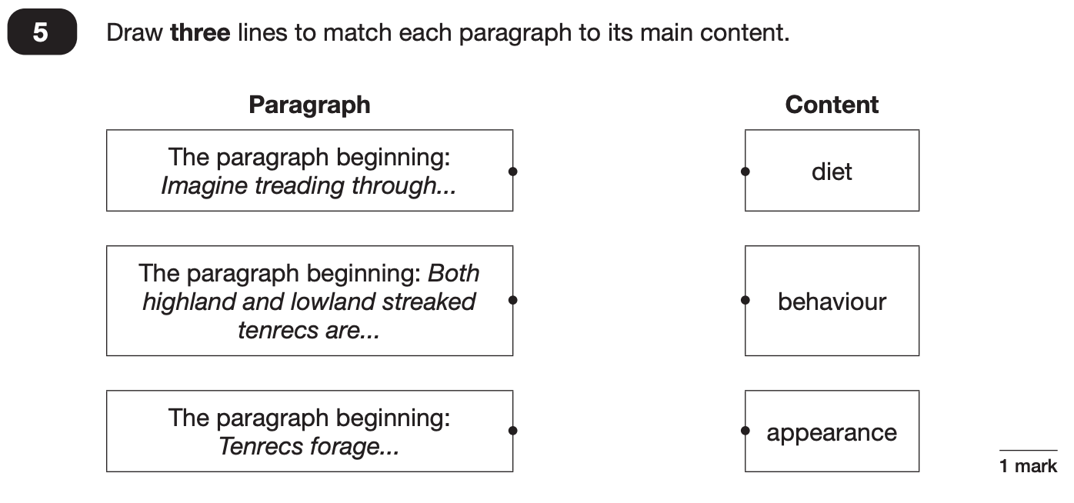
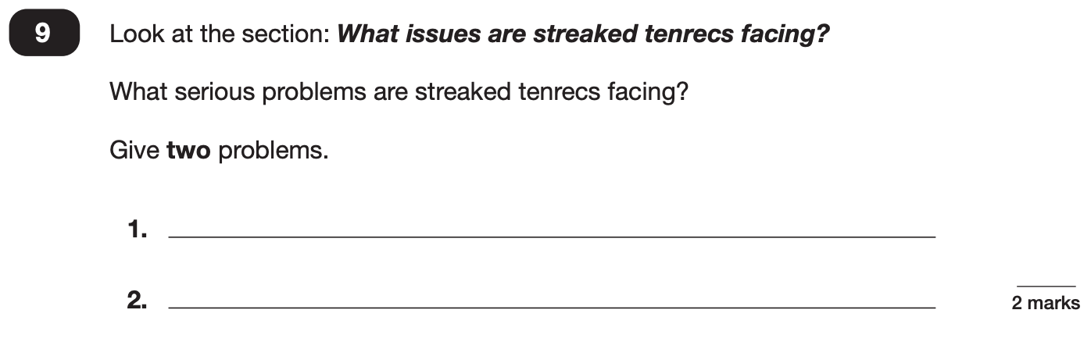
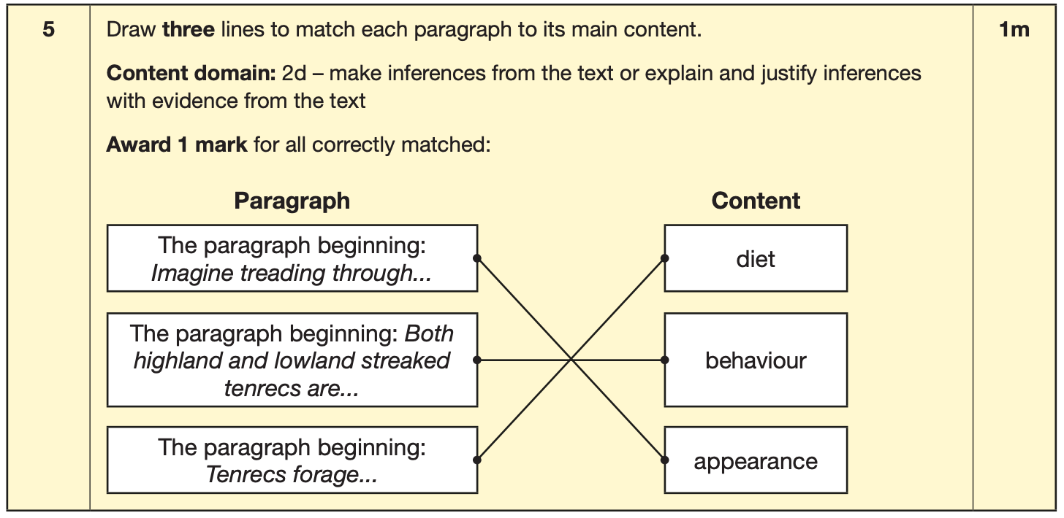
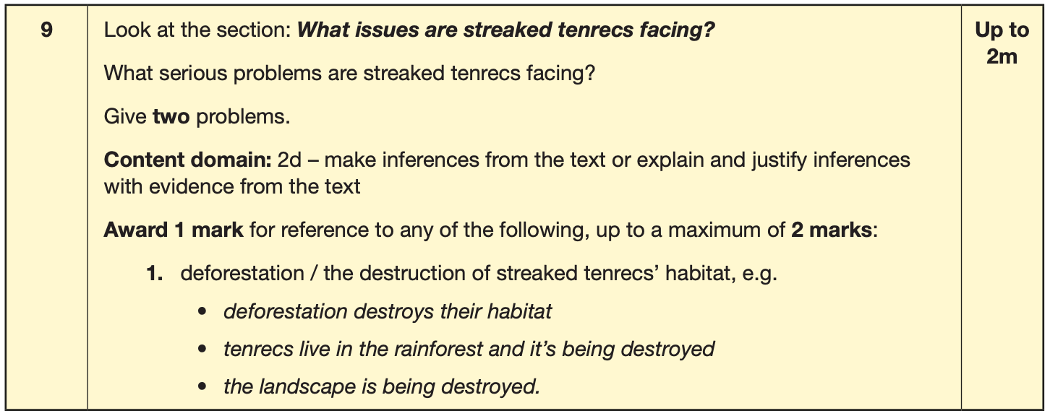
Reading
Example questions:
Notes:
Questions are from the 2024 Reading SATs paper.

Slide 13
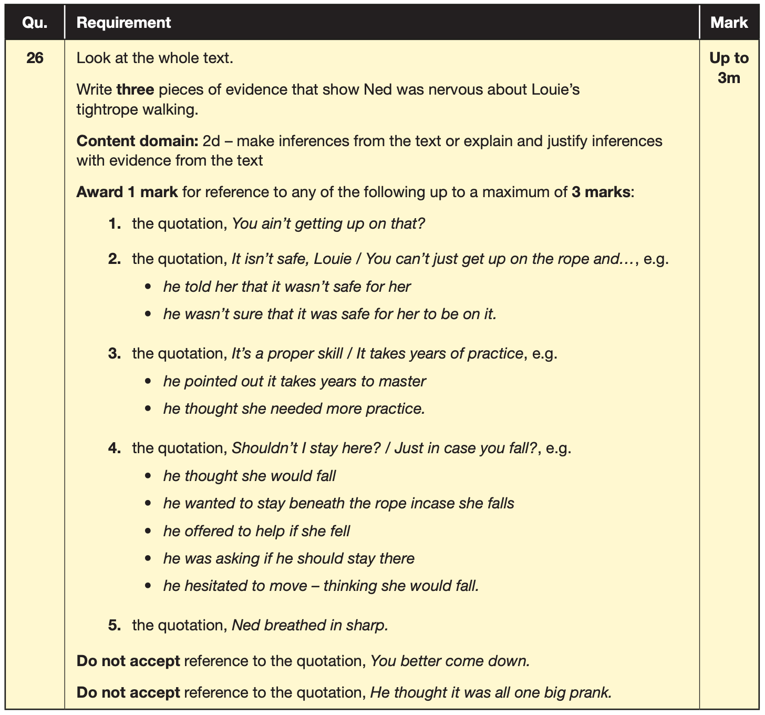
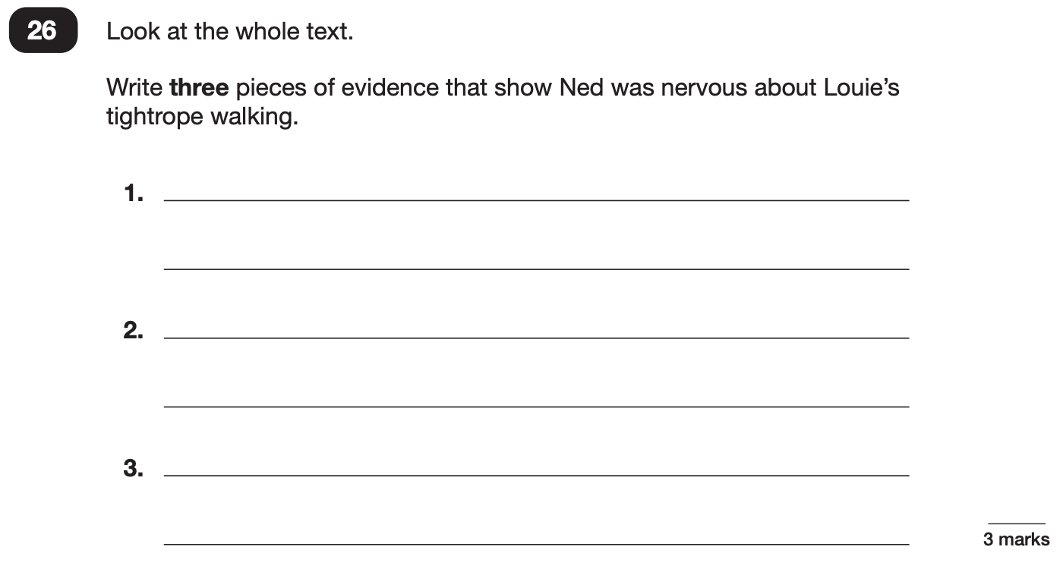
Reading
Example questions:
3 mark question
Notes:
Questions are from the 2024 Reading SATs paper.

Slide 14
Reading
Since the current testing formation for the SATs began in 2016, there has been a tendency for three types of questions to be the most popular.
In the 2024 Reading SATs paper,
10% of marks could be gained from answering questions involving giving and explaining the meaning of words in context;
38% of marks could be gained from answering questions involving retrieving and recording information or identifying key details from a text;
44% of marks could be gained from answering questions involving making inferences from a text and justifying inferences with text evidence.
When reading with your child at home try focusing on these types of questions.
Notes:
2% of questions: summarising main ideas from more than one paragraph.
6% of questions: making comparisons within the text
Example questions to ask at home:
What does this word mean?
Which word in this paragraph is the closest in meaning to…?
What [character] doing when [event] happened?
True or false questions about a paragraph/ text.
Why do you [character] did [event]? Can you think of another reason?

Slide 15
Maths: Wednesday 13th May and Thursday 14th May
The maths assessments consist of three tests.
Paper 1: Arithmetic (30 minutes) – Wednesday 13th May
Paper 2: Reasoning (40 minutes) – Wednesday 13th May
Paper 3: Reasoning (40 minutes) – Thursday 14th May

Slide 16
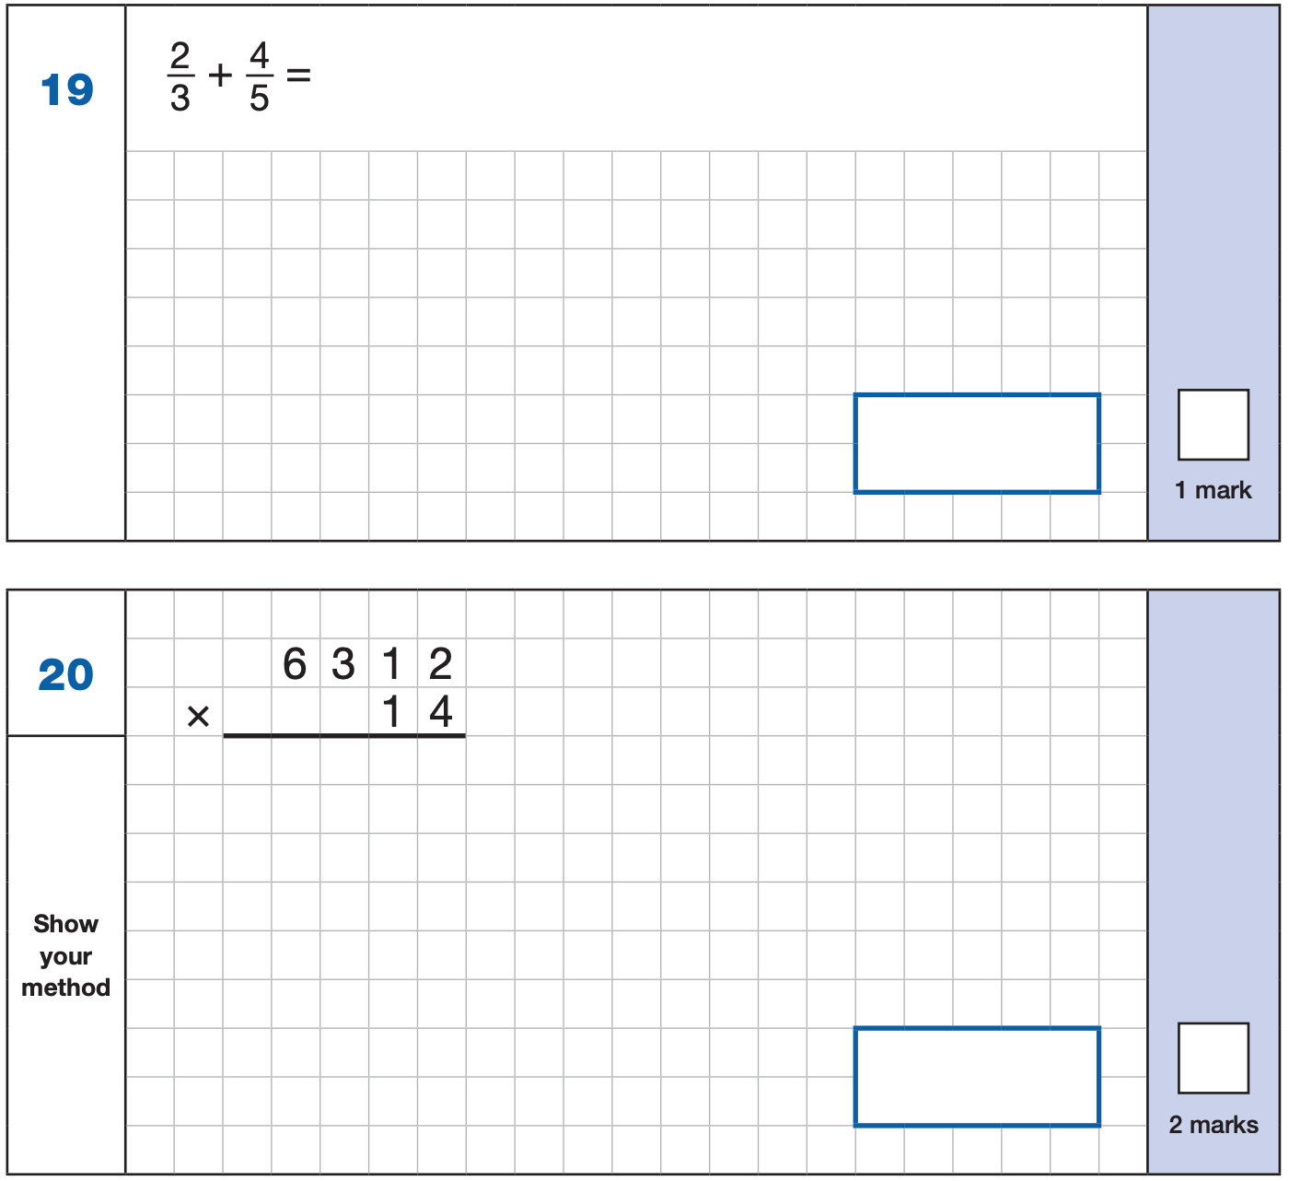
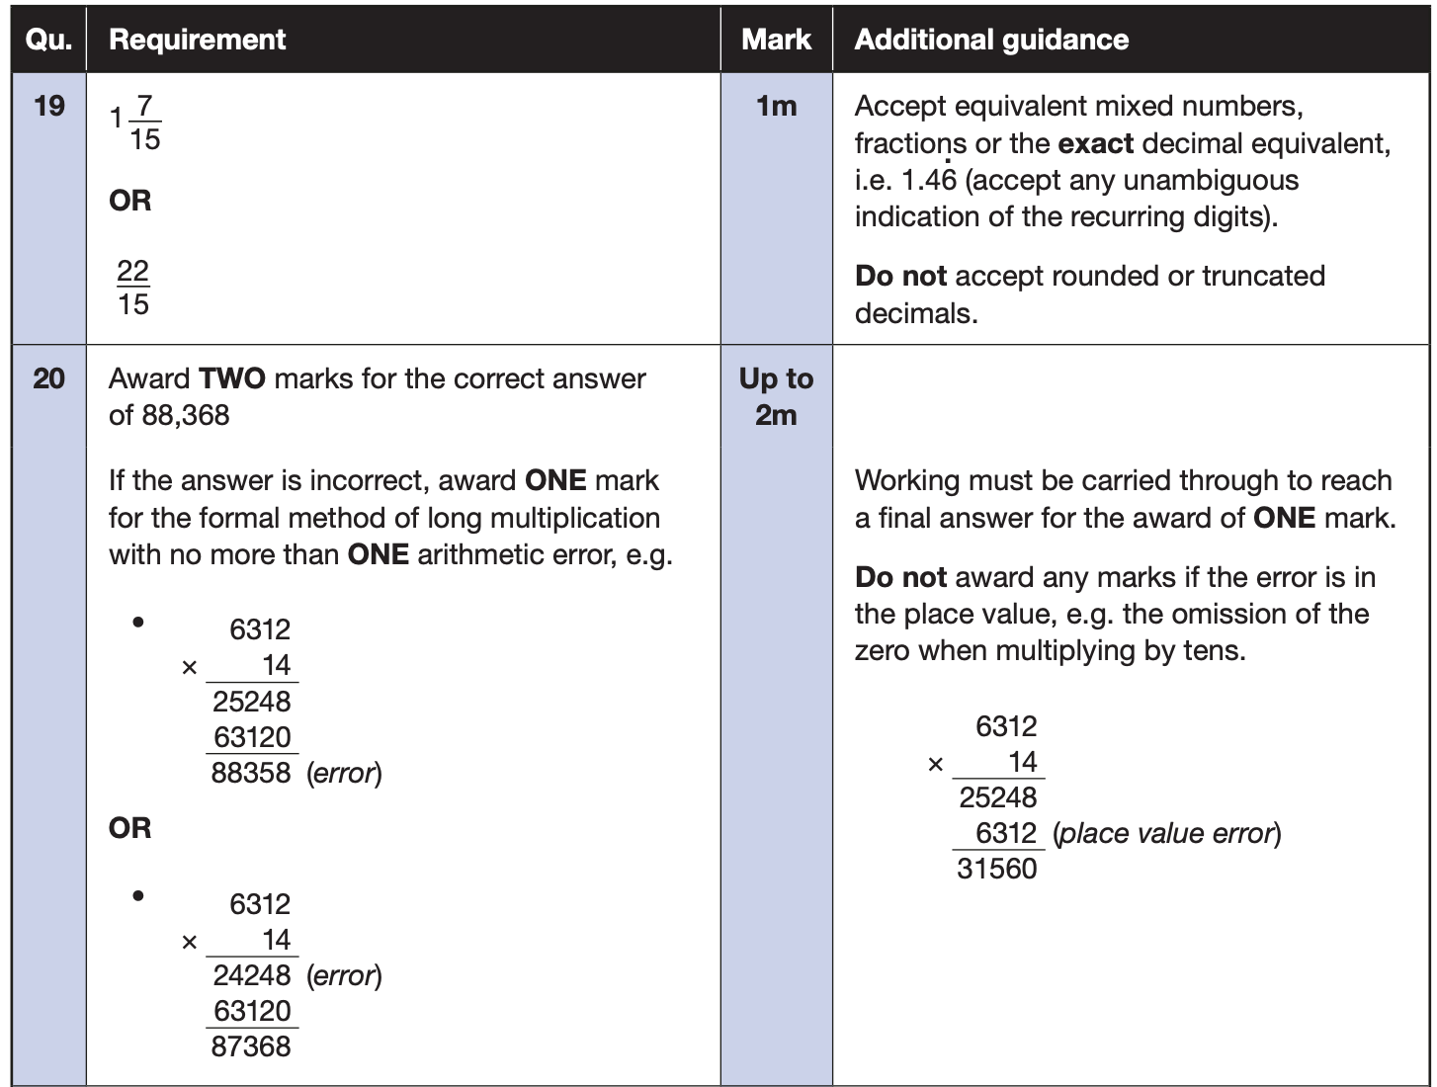
Maths Paper 1 (Arithmetic)
The maths arithmetic paper has a total of 40 marks and lasts for 30 minutes.
The test covers the four operations (addition, subtraction, multiplication, division, including order of operations requiring BODMAS), percentages of amounts and calculating with decimals and fractions.
Example questions:
Notes:
Questions are from the 2024 Arithmetic SATs paper.
Identify that there are some questions that have 2 marks and some that have 1.

Slide 17
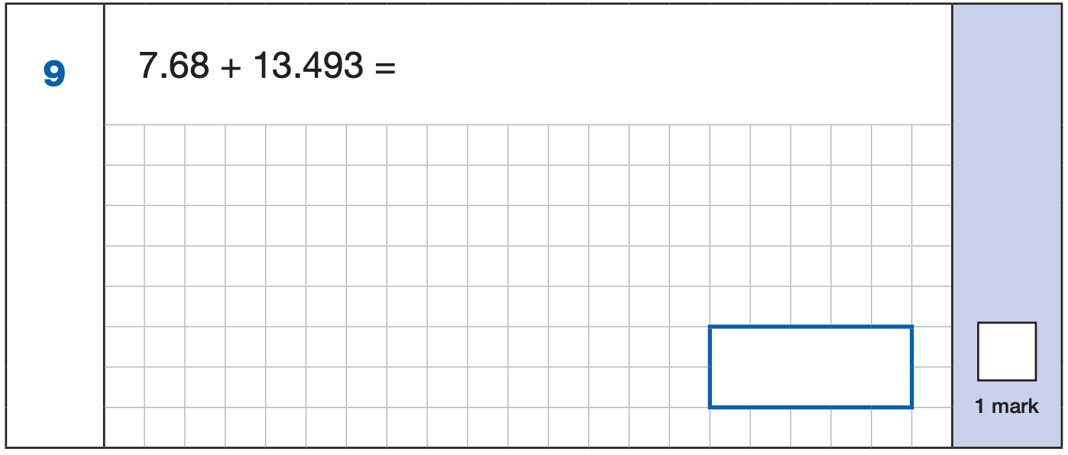
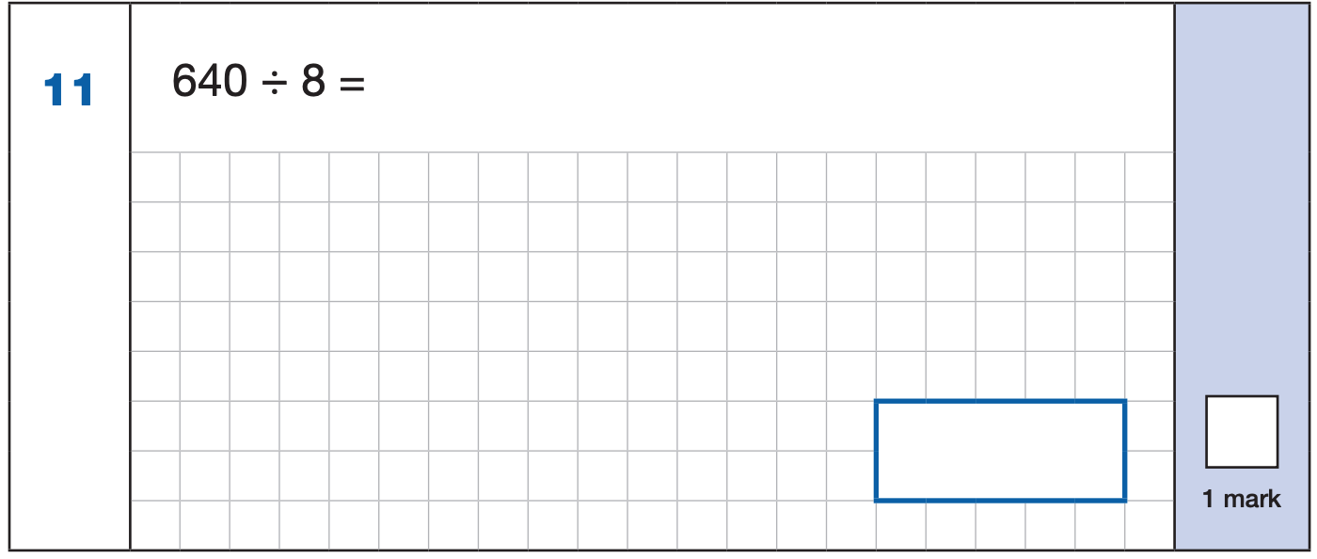
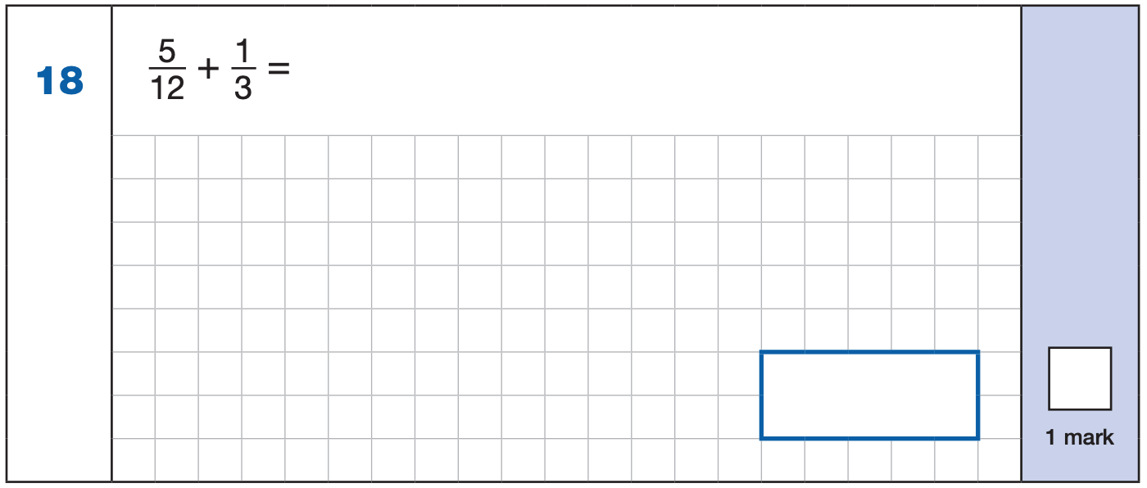
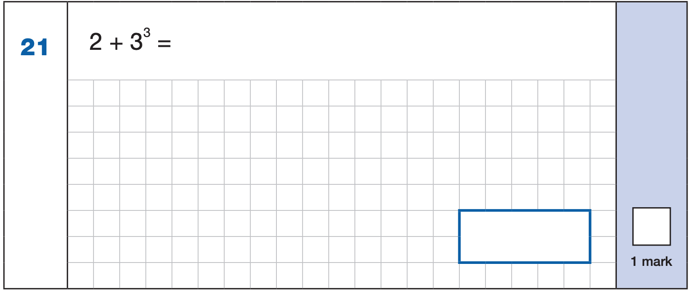


Maths Paper 1 (Arithmetic)
Example 1 mark questions:
7.680
+ 13.493.
21.173
¹ ¹ ¹
Mental method:
Using known fact of 64 ÷ 8 = 8
21.173
80
$\frac{\text{1}}{\text{3}}$ = $\frac{\text{4}}{\text{12}}$
$\frac{\text{5}}{\text{12}}$ + $\frac{\text{4}}{\text{12}}$ = $\frac{\text{9}}{\text{1}\text{2}}$
3³ = 27
2 + 27 = 29
$$\frac{\text{9}}{\text{1}\text{2}}$$
29
Notes:
Questions are from the 2024 Arithmetic SATs paper.
These are examples of how children could solve the calculations. There are some that could/ should be solved mentally as it is far quicker that way (40 marks in 30 minutes does not allow for 1 minute + per mark).
Answers should always be given in their simplest form unless stated otherwise.
Note that for question 18, equivalent fractions e.g. ¾ are accepted.

Slide 18
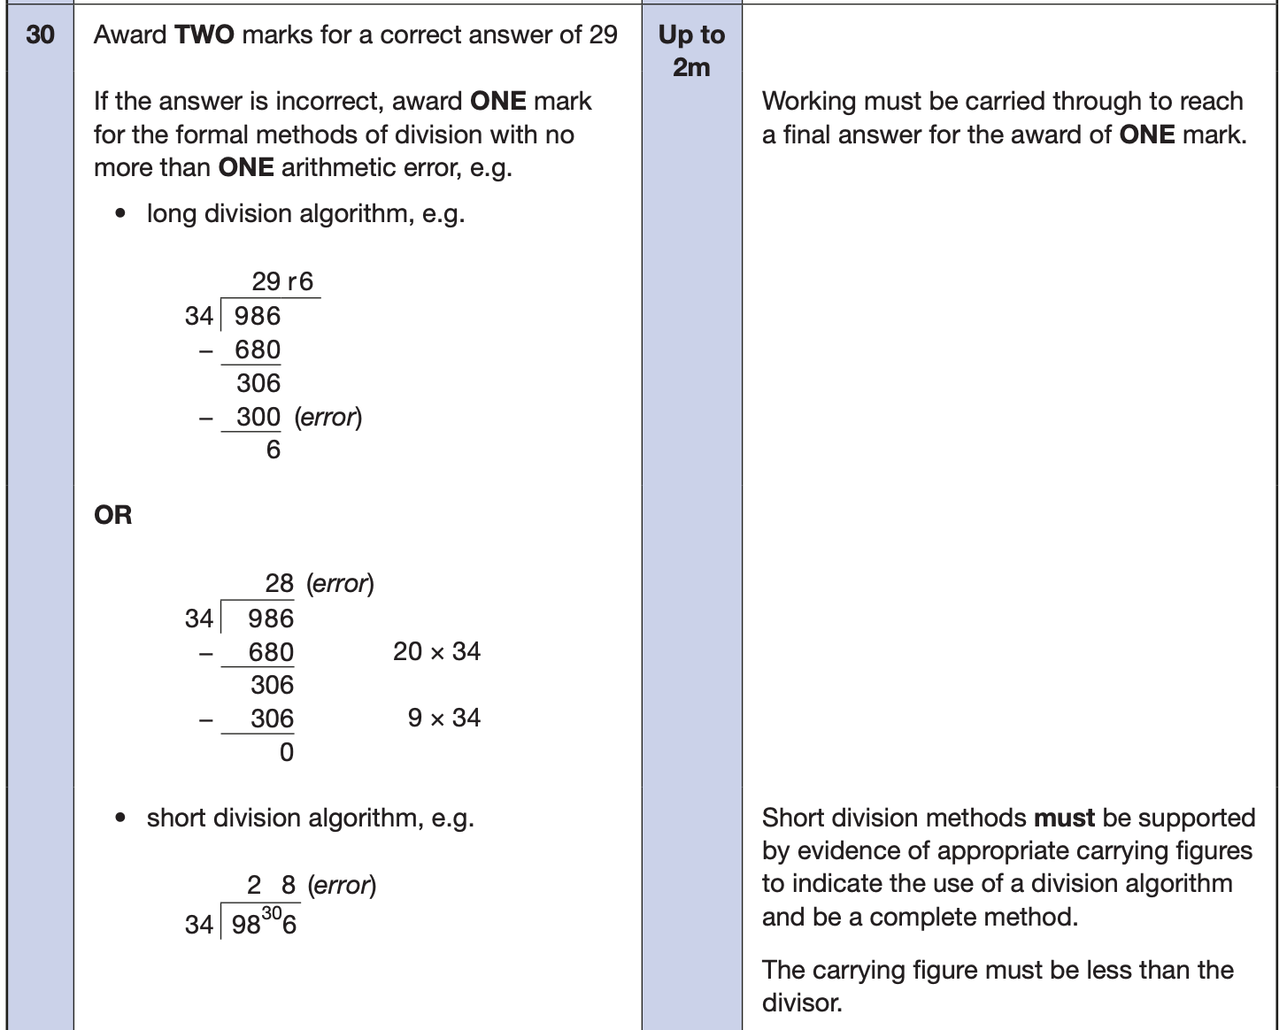
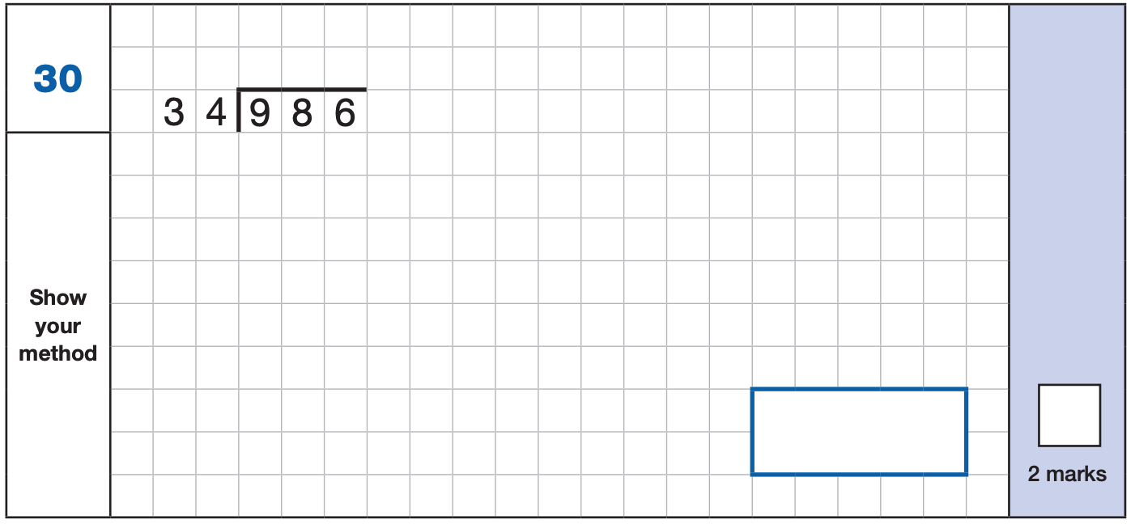
Maths Paper 1 (Arithmetic)
Example 2 mark question:
Notes:
Questions are from the 2024 Arithmetic SATs paper.

Slide 19
Maths Papers 2 and 3 (Reasoning)
Paper 2 will take place on Wednesday 13th May and paper 3 will take place on Thursday 14th May. These tests have a total of 35 marks each and lasts for 40 minutes each.
These papers require children to demonstrate their mathematical knowledge and skills, as well as their ability to solve problems and their mathematical reasoning. They cover a wide range of mathematical topics from key stage 2 including,
Number and place value (including Roman numerals);
The four operations;
Geometry (properties of shape, position and direction);
Statistics;
Measurement (length, perimeter, mass, volume, time, money);
Algebra;
Ratio and proportion;
Fractions, decimals and percentages.
Notes:
In general, the questions get progressively harder throughout the paper. As this is the case, it is not unusual for children to be unable to complete the entire paper in the given time.

Slide 20
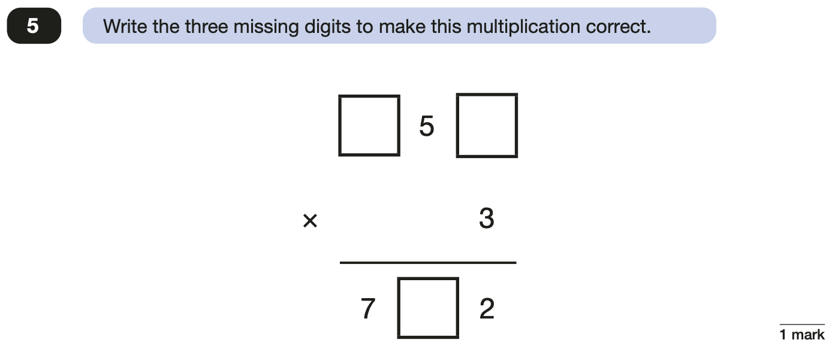
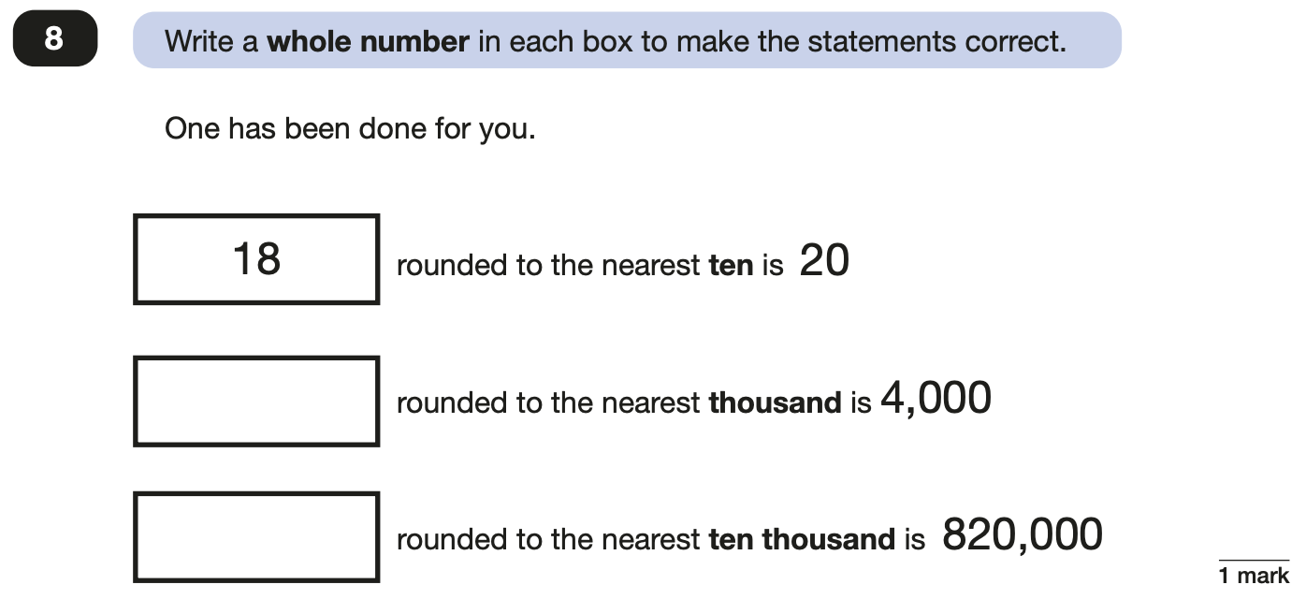
Maths Papers 2 (Reasoning)
Example questions:
2
4
3,500 to 4,499
6
815,000 to 824,999
Notes:
Questions are from the 2024 paper 2 Reasoning SATs paper.

Slide 21
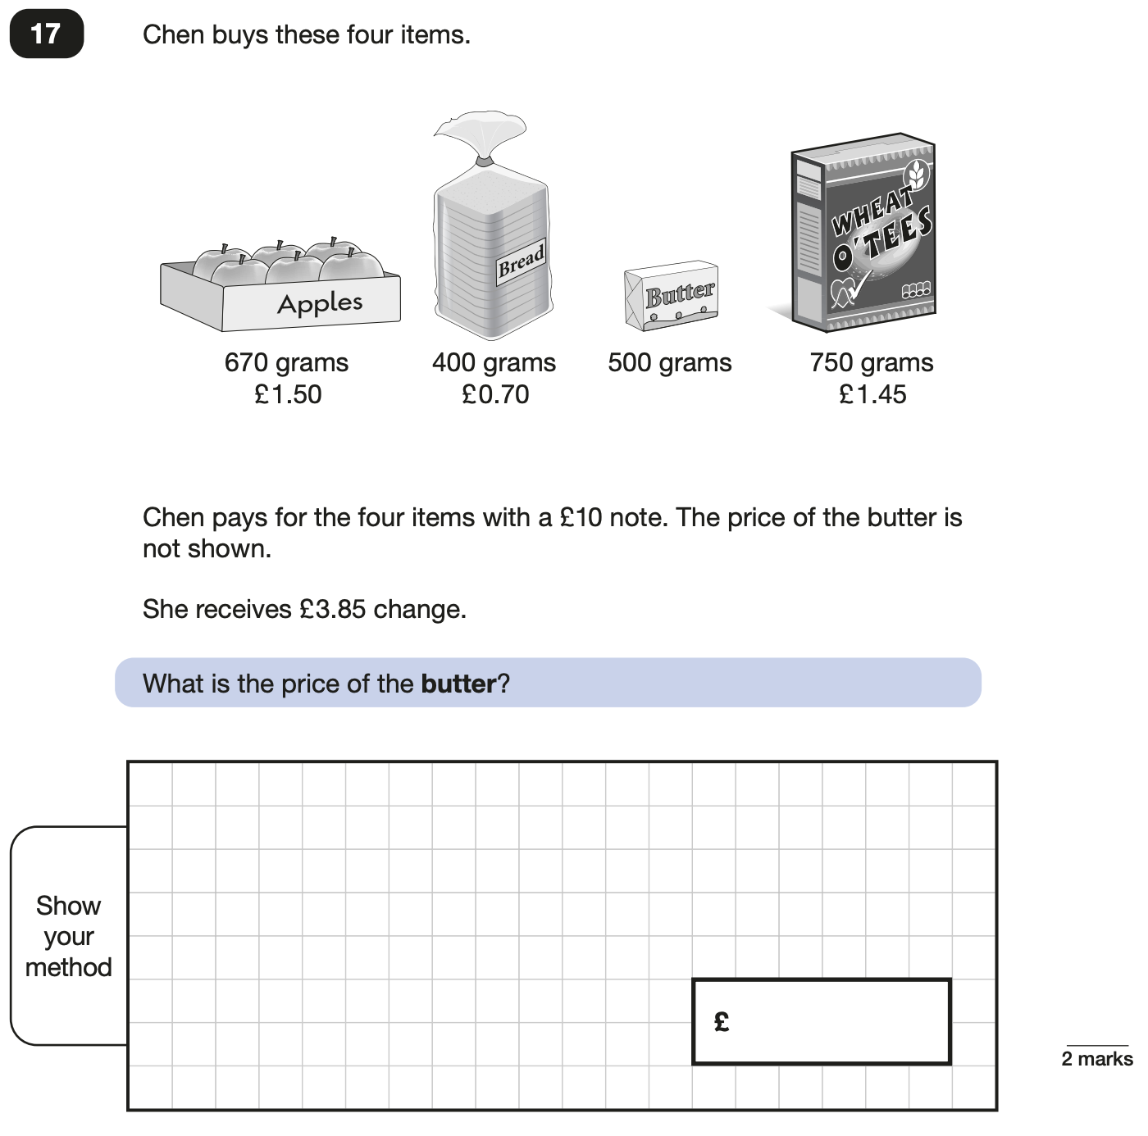
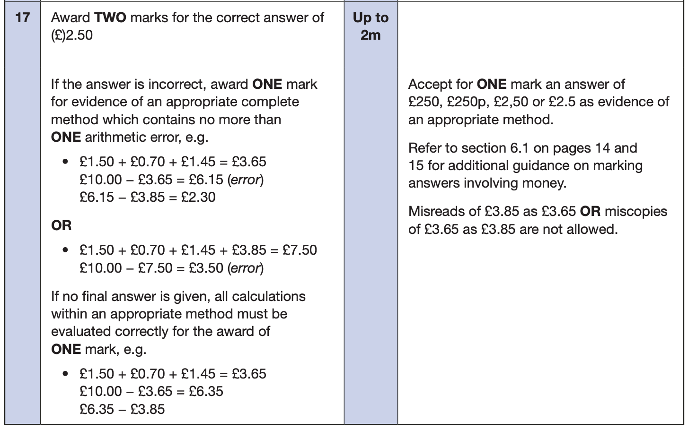
Maths Papers 2 (Reasoning)
Example questions:
Notes:
Questions are from the 2024 paper 2 Reasoning SATs paper.

Slide 22
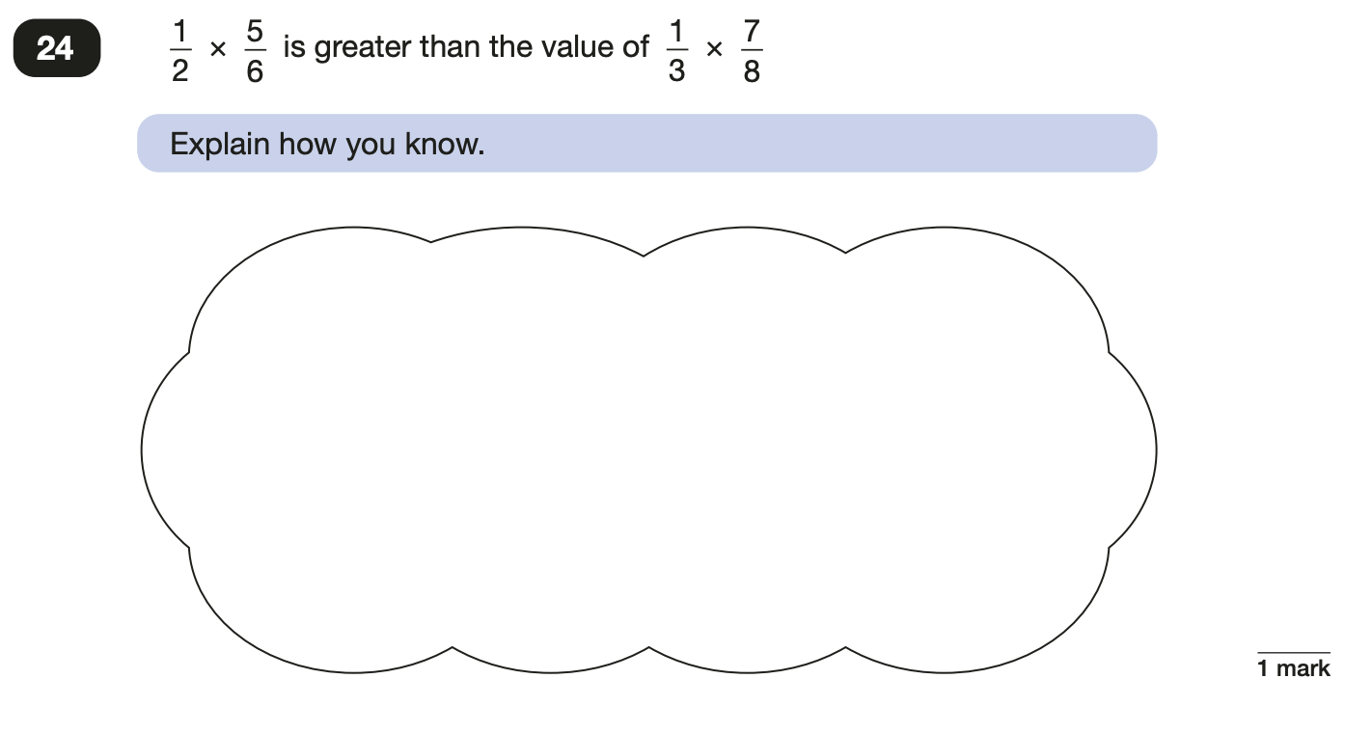
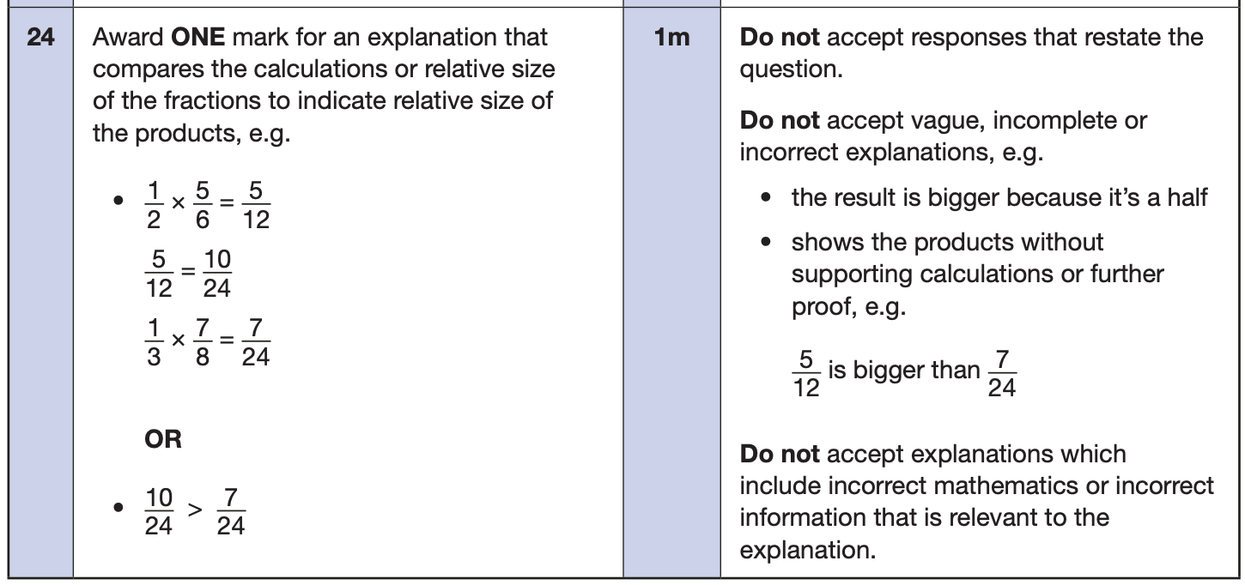
Maths Papers 3 (Reasoning)
Example questions:
Notes:
Questions are from the 2024 paper 3 Reasoning SATs paper.

Slide 23
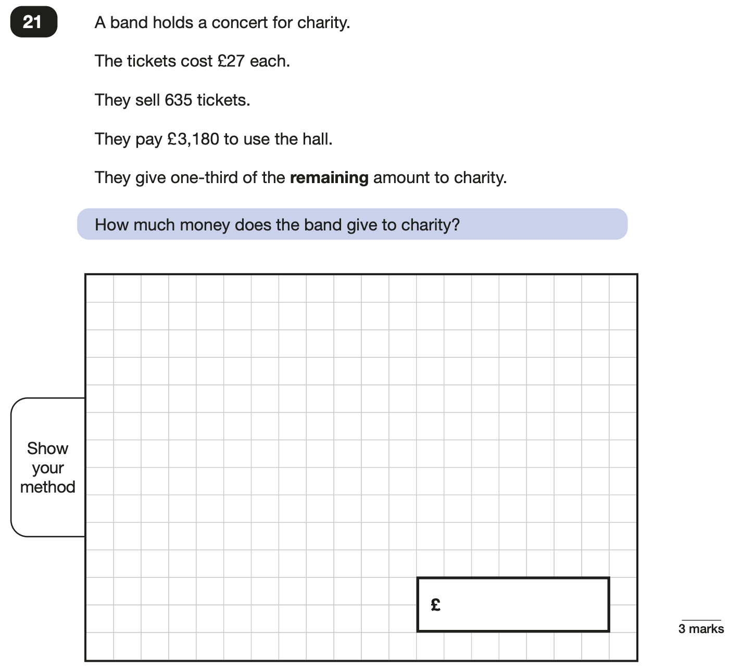
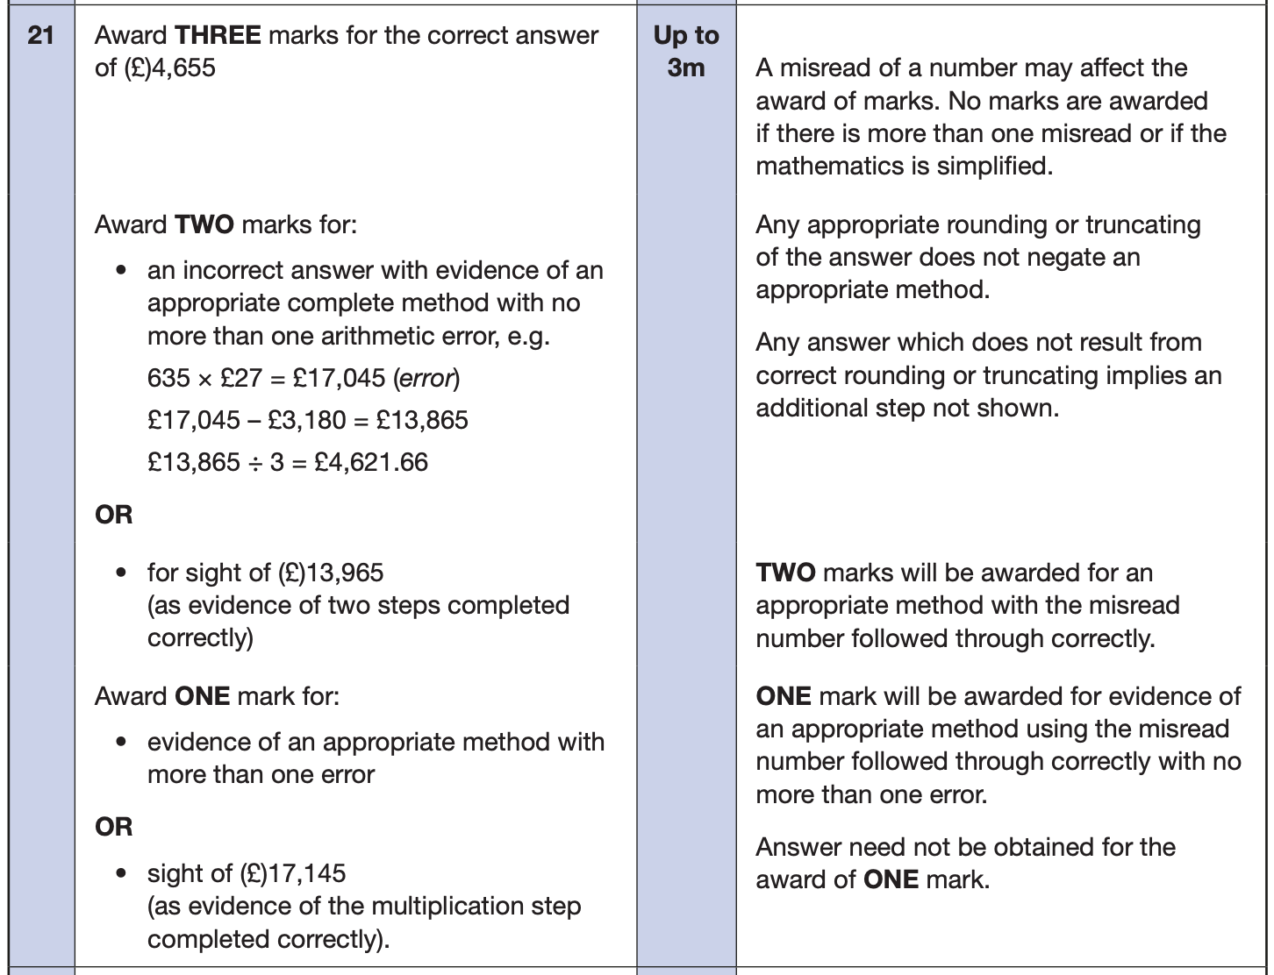
Maths Papers 3 (Reasoning)
Example question:
Notes:
Questions are from the 2024 paper 3 Reasoning SATs paper.
Note that this is a three mark question.

Slide 24
How can parents help?
Firstly, a positive attitude goes a long way. Give them as much encouragement and support as you can (but we don’t need to tell you that!)
Sensible bedtime.
Healthy diet – eat breakfast.
Drink plenty of water at home and school.
Encourage your child positively, without putting too much pressure on him/her.
Support with homework – provide a quiet place for work.
Use revision guides and websites to support your child’s learning.
Encourage you child to ask if they are unsure of anything.
Create a revision timetable that works for you and your child. For some families, 10-20 minute activities over a few days works best. For others, a longer study session once or twice a week may be better.

Slide 25
How can parents help?
Firstly, a positive attitude goes a long way. Give them as much encouragement and support as you can (but we don’t need to tell you that)!
Sensible bedtime.
Healthy diet – eat breakfast.
Drink plenty of water at home and school.
Encourage your child positively, without putting too much pressure on him/her.
Support with homework – provide a quiet place for work.
Use revision guides and websites to support your child’s learning.
Encourage you child to ask if they are unsure of anything.
Create a revision timetable that works for you and your child. For some families, 10-20 minute activities over a few days works best. For others, a longer study session once or twice a week may be better.
Homework Club and Revision Clubs.

Slide 26
Things to remember about SATs
SATs focus on what children know about Maths and English.
They will not reflect how talented they are at science, geography, art, PE…, and they certainly won’t highlight all their amazing personal characteristics.
SATs don’t tell the whole story.
Their results will say if they did or did not meet a certain standard but not necessarily by what margin. These thresholds change each year according to the overall national performance, so what was classed as ‘meeting the expected standard’ this year might not be the same as last year. We will be able to provide you with more detailed feedback.
SATs are only four days out of a whole Primary School career.
In reality, there's one or two papers each day that last 30 to 60 minutes.

Slide 27
What to do if you are worried about your child
Talk to the school
Sometimes concerns present at home and not at school. If you notice a change in your child, talk to the school so that everyone concerned can offer the support needed.
Talk to your child
Talk to your child about what aspect of SATs concerns them the most. If you can help them pinpoint what is bothering them the most, you can take specific steps to help reassure them.
Encourage your child to talk to their teacher
SATs are obviously linked to school. Don’t be surprised if your child would prefer to seek reassurance from teachers over family members.
Try not to project your own anxieties about the SATs
Children can be very intuitive. If they see that you are anxious, this could add to their own anxieties.
Notes:
It may also be appropriate to discuss if there are any changes at home that could add stress to the child (e.g. moving house, a new sibling, recent bereavement).
There may be media coverage around the SATs, parents may want to discuss this with their children (positive or negative).

Slide 28
Advice for Year 6 children
Listen to your teacher.
The adults you work with all want you to do your best.
Get plenty of sleep and eat well, this will help your brain.
Read all the questions carefully. This can help you to avoid silly mistakes.
Don’t panic. There may be questions you think you can’t answer. Take a deep breath. Read it again. You can always move on and go back to it later. It’s often better to write something rather than nothing.
Remember that the Year 6 SATs last for 4 days out of your whole life!
“Stay focused in class so you don’t have loads of extra studying to do at home!” – Year 7 pupil’s advice.

Slide 29
For further support please refer to The KS2 SATs page on our school website.

