Slide 1

Mill Lane
Community
Primary
School
Welcomes You

Slide 3



May we introduce
Miss Tineke van der Ploeg
Headteacher
Mr Sam Thompson
Deputy/ Class teacher
Mr Matthew Wingrove
Bursar
Mrs Jackie Wingrove
Inclusion Manager
Mrs Caroline Hiley
Administration

Slide 4

Meet the Teaching Staff
Nursery Teacher Mrs Amanda Payne
Reception Class Teacher
Miss Suzie Pocock
Year 1 Teacher
Mrs Tina Zychowicz
Year 2 Teacher
Mrs Lottie Jones
Year 3 Teacher
Mr Sam Thompson & Mrs Saskia Sharkey
Year 4 Teacher
Mrs Nicky Palmer & Mrs Sarah Redrup
Year 5 Teacher
Miss Imogen Rea
Year 6 Teacher
Mrs Ali Kershaw
Music Specialist/choir lead
Mr Sam Thompson
P.E Specialist
Mr Ben Davis

Slide 5
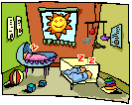
And also Support Staff
Foundation Classes (age 3 – 5)
Nursery: Mrs Bev Hardstaff,
Mrs Emma Rockall and
Mrs Amanda Maxwell
Reception Class:
Mrs Mia Neasham
Mrs Angie Oakley
Mrs Michelle Morgan
Key Stage 1
Class 1 :Mrs Sarah Kennedy,
Mrs Sian Kelly
Mrs Lynne Worley
Class 2: Mr Ben Davis, Miss Claire O’Brien
Key Stage 2
Class 3: Mrs Juliette Richards, Mrs Sarah Daly, Mrs Nicky Gilbert
Class 4: Mrs Debbie Godfrey, Miss Ruby Matthews, Mrs Andrea Leaesley
Class 5: Mrs Sue Sheen, Mrs Sarah Richardson
Class 6: Mrs Alison Bird, Mrd Sheryl Hipwell

Slide 6
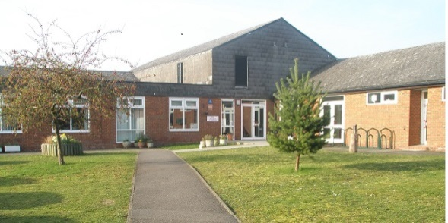
Mrs Wiggins, Mrs Vernon &
clean our School
Mr Victor Zammit
is our Premises Manager
It is always helpful if children recognise the school building or the playground before your child starts school. Walk here several times together so that he/she will get to know the way and recognise the area.
For safety, your child should know and be able to tell his/her first and last names and address to an adult who is known and trusted.
It is very important to inform us if someone, other than yourself, will be bringing your child to school or collecting him/her at the end of the day. You can do this by telling the class teacher when you drop your child off or ringing the school office.
If you should be late to collect your child, they will be waiting by the school office until you arrive. Please let the person in the office know you are there to collect them.

Slide 7
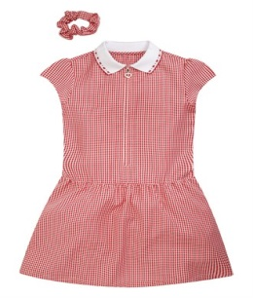
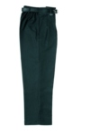
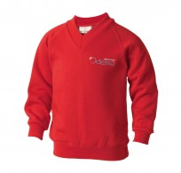
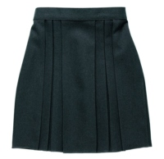
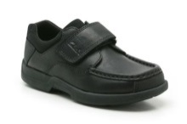
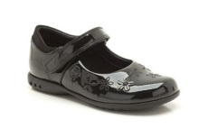
School Uniform
The school has a uniform which we encourage all children to wear; bright red Mill Lane sweatshirts, fleeces or cardigans, red/white polo shirts grey/black trousers or skirts.
In the warmer weather girls may choose to wear red and white dresses. For outdoor wear we have reversible red jackets.
School uniform can be viewed in the school entrance hall along with the order forms and can be purchased from MPSworkwear.co.uk - it can also be ordered from Tesco online.
Footwear
Everyday footwear should be of a sensible
fashion. No open toed sandals are
allowed in school because of the
accidents caused to exposed toes.
When children are young, please avoid shoes with laces, belts with stiff buckles, difficult buttons, hooks and eyes and ties that need knotting etc.
Jewellery
Necklaces, rings or bracelets must
not be worn in school. Anyone with
pierced ears must only wear studs for
school and these must be removed or
taped for PE.
Children are responsible for bringing their own tape to school for this.

Slide 8
Some Practical Points.
All children should wear sensible and appropriate clothing following the school colours of red, white, grey or black, should they not wear the uniform. Clothing should be washable, sturdy and allow for independence in dressing and undressing. Encouraging your child in self-help skills, will make them more independent and increase their self-esteem when in school.
Strappy or short tops are not appropriate for school wear and are unsuitable for PE lessons. In Reception class children go out in all weathers and will need wellington boots.
Children in reception class will not need PE footwear in the first term. Please ask the class teacher when these will be needed.
Children must bring some form of overall for the more creative activities, an old shirt is fine.
During warm weather we suggest that children wear sun hats as we only have limited shade (please make sure they are named).
Please, please put a name on every article of clothing, including underwear, shoes, plimsolls, P.E. kit and especially MILL LANE SCHOOL SWEATSHIRTS, FLEECES AND WATERPROOF JACKETS! We have an enormous amount of unnamed clothing in our lost property, if it is named we can try to reunite it with its owner.
School Uniform should be worn for all school visits and formal events.
Children must have a P.E kit available each day.
This should be a t-shirt, shorts and suitable footwear (plimpsoles or trainers).
In winter children may wear a track suit for P.E.
All these items must named and be kept in school, in a named bag.

Slide 9
Our school meals are provided by
Oxfordshire County Council.
Menus are available from the school office and are on the school website. We offer jacket potatoes with various fillings in addition to the menu, should your child not be able to find something they like.
Letters about our school meals are sent
home at the end of each term.
If you wish your child to have a hot school meal, please book online using the School Comms system. Payments can be made online via the online payment system.
The school operates a cashless system and all payments are made using the online system. When you start school, login details will be sent to you.

Slide 10
Home School Partnership.
At Mill Lane School we regard education as a partnership between home and school. We hold regular meetings with you to discuss your child’s progress.
If you have concerns or questions at other times, please see or telephone your child’s class teacher to arrange an appointment. After school is preferable to before school, which is always very busy.
Home School Agreements
We have a home school agreement which we ask you to read through and discuss as appropriate with your child. As your child gets older, we will ask them also to sign this agreement. This helps us to work together
in supporting your child’s education.
Photographs and videos of achievements,
activities and events at school are often
taken. We may occasionally use these in publicity, for display at school or newspaper articles etc. We need you to complete the photography and video form in the admission pack to inform us of your wishes.
Your child will be regularly using the computer.
To allow your child access to the internet a permission form will be required.
Please complete the forms in the admission pack:
Home School Agreement.
Photography & Video.
Internet Permission.

Slide 11

School Times:
Breakfast Club 8am – 8.40am
Reception Class:
School start time 9.00am.
Lunchtime 11.45am - 1.00pm.
End of school 3.00pm.
Children in Reception and KS1 will be provided with fruit at snack time
KS1
School start time 8.40am.
Lunchtime 12.00pm - 1.00pm.
End of School 3.15pm
KS2
School start time 8.40am
Year 3 & 4 Lunchtime 12.00pm - 1.00pm
Year 5 & 6 Lunchtime 12.15pm - 1.00pm
End of school 3.15pm.
After School Club: 3.00pm – 5.30pm
(Time Out Club)
You will need to book using the online system, the cost is £9.00 per day.
Breakfast Club
You need to book a place using the online system.
The cost is £2 to attend and then the price of the breakfast.
The children are supervised until it is time for school to start. The older children will then line up on the playground while the younger children are taken to class by the supervisor.
Year 2 to Year 6, can cook their own breakfast by booking to join the cookery club for their year group. The cost is £2.

Slide 12
Mill Lane Community
Primary School
After School Care
Monday to Friday 3pm—5.30pm
Children must be registered before attending
A Snack and Drink will be provided
Cost £9
For more information please contact the school office
on 01844 352106
Time Out Club
Mill Lane Community Primary School
Breakfast Club
Hours 8am – 8.40 am Monday – Friday
For Children aged 4 – 11
Cost £2 per day You must book in advance
SAMPLE MENU
  Slice of Toast with Butter & Jam 15p
  Crumpets 30p
  Cereal with Milk 50p
  Sausage in a Roll (not available every day) 50p
  Orange/Apple Juice/Milk 30p
For Details ring 01844 352106

Slide 13
MILL LANE SCHOOL ASSOCIATION (MLSA).
All parents and members of staff automatically belong to the MLSA
The MLSA raise funds for the children at school which helps with the cost of the internet, extra resources for classes, an outing to the pantomime and much, much more.
The school could not provide all this without them. Please try to support the events they organise.
Meetings are held monthly usually the first Monday in the month. If you would like to attend please contact the school office for details.
They always need people to help be it on the committee or just to put your name down as an extra pair of hands at an event would be more than welcome.

Slide 14

Mill Lane
Community
Primary
School
Mill Lane, Chinnor,
Oxon., OX39 4RF
Telephone 01844 352106
www.mill-lane.oxon.sch.uk

