Slide 1


Weekly Newsletter – 3rd October 2025
Harvest: Our theme for harvest this year has been ‘Field to Fork’ and each of the classes has been looking at how different, everyday foods are produced. The Reception children have been making toast today and Year 1 have been drawing and sorting beans and will be making bean soup next week. The Year 2 children have made bread, whilst the Year 3 children enjoyed making and eating a pear crumble. The Year 4 children made their own vanilla ice cream and the Year 5 children have made coffee. If you come to our harvest assembly on Wednesday 8th October at 9am you will have the opportunity to see the children’s work. Don’t forget, harvest donations can be brought to the main hall on Wednesday morning as the children arrive. Hopefully we will see lots of you at our celebration.
Stars of the Week
OPEN EVENING
This week our stars are:
Y1: Leo Teixeira-Palmer, Jayden Kent
Y2: Josie Thomas, Finley Gregory
Y3: Rosie Rae Cain, Max Turney
Y4: Freddie Milne, Evalyn Whittaker
Y5: Charlie Tucker, George Eaglestone
Y6: Phoebe Caffyn, Max Thomas
Golden Pencils were awarded to Jude Horner and Charlie Casey in Year 6 for their improved handwriting.
We will be holding our first open evening on Wednesday 8th October at 6pm to 7pm. This will be an opportunity to see how we teach spelling and phonics across the school and how you could support your child at home. Each class will have a range of activities for the children to have a go at and demonstrate what they do in the class. Therefore, we would love to see not only you but also your child / children. Doors will open at 6pm and you can move around the classes at your leisure. The teachers will be available for you to chat to in regards to how we teach phonics and spellings. If the evening proves popular, we will repeat later in the year for reading and maths.
We will have a more formal parents evening after half term and also there will be an opportunity to see your child’s work. These dates are all on the first term’s newsletter that went out but here is a reminder:
Wednesday 3rd December 3.30pm – 6pm an opportunity to look at your child’s work
Wednesday 10th December 3.15pm – 8.30pm Parents evening – an opportunity to meet with the class teacher.
This year we will also be introducing termly report cards which will give a brief summary of what your child has covered over the 2 terms and how well they have done. The first report card will go out on Monday 8th December just before parents evening. Hopefully, these events will help you gain a better understanding of how your child is doing.

Slide 2

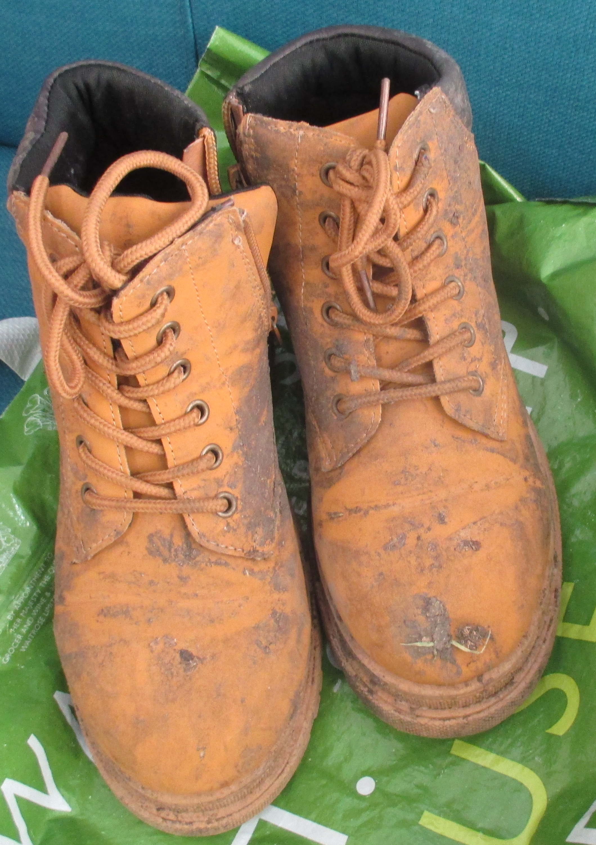
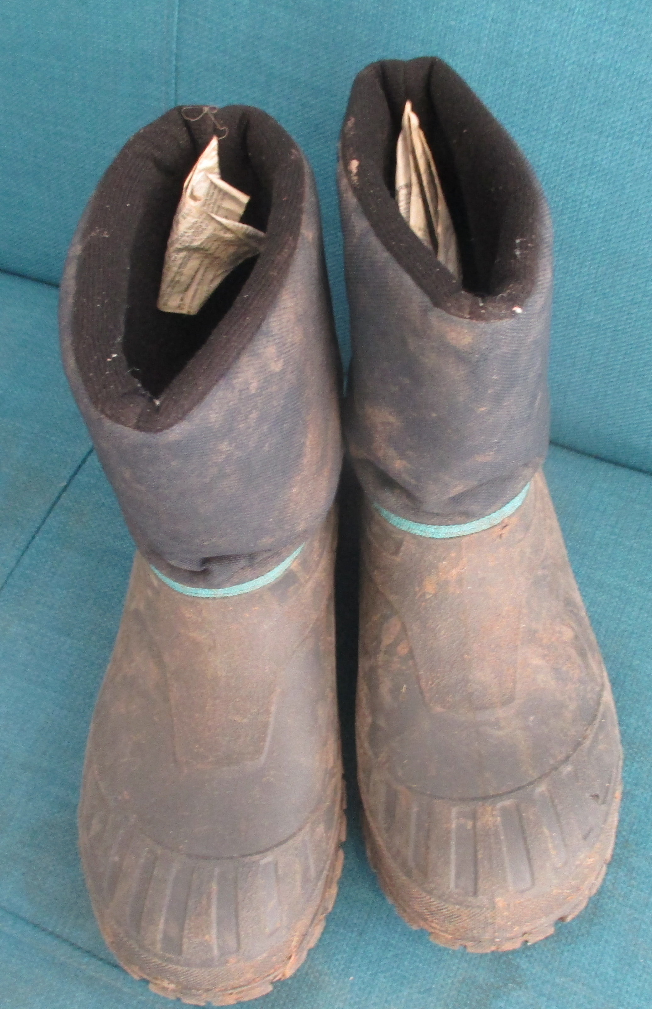

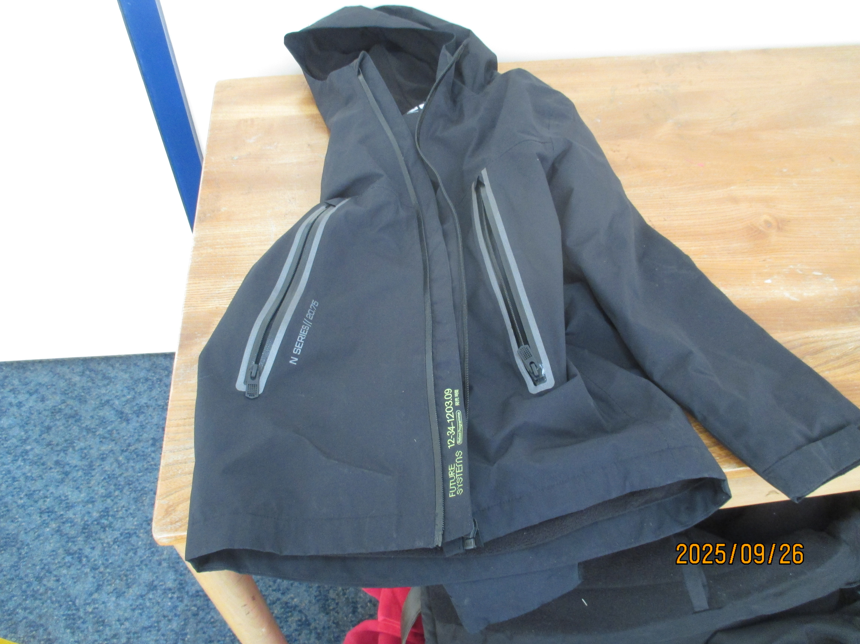
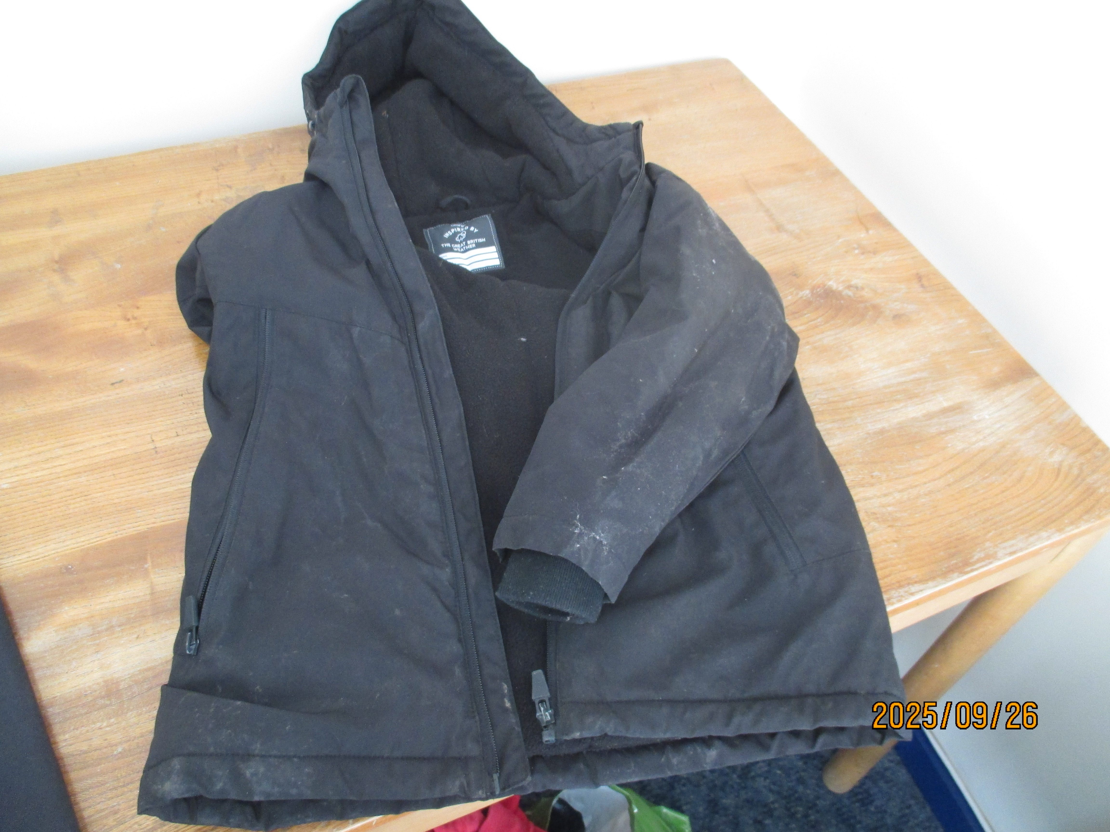
Dates for your diary
Reminder of Dates:
Wednesday 8th October at 9am Harvest Festival: Donations of dried, tinned and packets of food are warmly received. Please bring these to the main hall on the morning.
Wednesday 8th October at 6pm: Open Evening to see how we teach phonics / spelling and reading
Monday 13th October: Flu vaccines for all children
Friday 17th October: MLSA Halloween Disco
Friday 24th October: Last day of term
Monday 3rd November: Return to school
Monday 3rd November: School photos`
Class Activities:
Monday 6th October: Whole school assembly on hedgehogs
Monday 6th October: Year 5 poetry workshop
Tuesday 7th October: Whole school ‘Farm to Fork’ workshops
Thursday 16th October: Year 5 & 6 talk with local community police around bullying, social media and general behaviour
Monday 20th & Tuesday 21st October: Art workshops for all the children
The lost property basket at the front of the school is still overflowing with jumpers so if your child has lost a jumper it might be worth popping in to check if it is there. All these items are not named so it is hard to return them to the right person. At the end of the term, we will clear the basket of all items by recycling the items where possible. Below are some photos of items that someone might recognise:
Lost Property
For any queries in response to this message please email (head.2465@mill-lane.oxon.sch.uk) or telephone (01844 352106) the school office.

