Slide 1
Year 6 Teams Meeting
English Transition Work

Slide 2
You need to persuade us that YOU are the special one and not Emmet.
Emmet is an ordinary man who lives his life according to a set of instructions.
His only creative thought is for a double-decker sofa.
You need to outline what makes you more special than Emmet.
You need to focus especially on what makes you more of a creative builder!
What could you build with all of the pieces of Lego in the world
(can you beat a double-decker sofa)?

Slide 4
Emmet
Clumsy
Unimaginative (follows the crowd)
Not athletic
Enthusiastic
Immature
ordinary

Slide 5
You
Resilient
Experience building
Persevere
Hard-working
Committed/dedicated
Creative

Slide 6
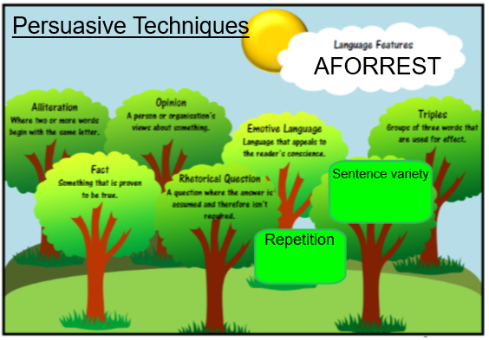

Slide 7
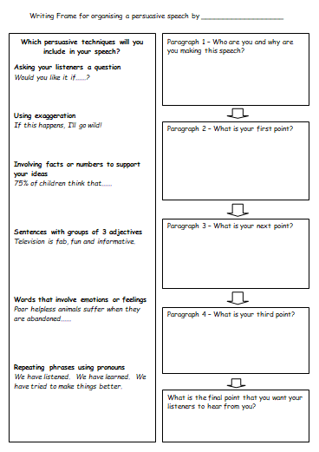

Slide 8
Do you really want to be responsible for the downfall of LEGO City?
I am the number 1 builder and creative thinker in the whole world!
99% of the LEGO City population agree that I am the most suited for the job.

Slide 9
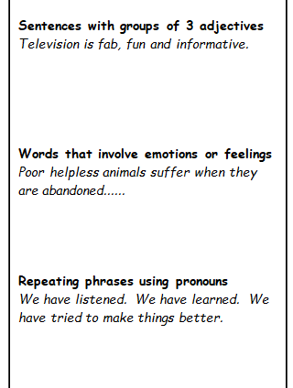
I am an enthusiastic, creative and hardworking member of Lego City, who would love the opportunity to become the MasterBuilder to save the citizens.
Poor helpless citizens of our city will suffer if you appoint Emmet to be the MasterBuilder.
We should make a stand. We should choose the best person for the job. We should defeat our enemy!

Slide 10
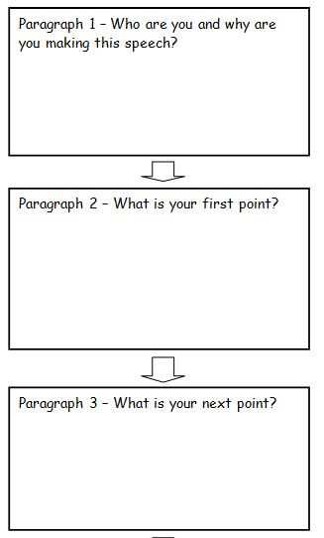
Good morning citizens of Lego City/Good morning Year 7 English teacher.
I am here today to explain to you that I wish to apply for the role of Master Builder. I strongly believe that I can save Lego City from the sly enemy so the citizens should choose me, before it’s too late!
Firstly, I am a creative individual, who does not blindly follow the crowd. I can make decisions for myself and I have a million and one ideas for how to defeat our enemy. Unlike Emmet, my ideas are totally unique and ground-breaking. Alongside this, everyone knows that I am the most hardworking person you will ever meet. In fact, I am the number one builder and creative thinker in the whole world!
apply for the job of Master Builder
Can save Lego City
Citizens should choose me
Creative – don’t follow crowd
Hardworking
Lots of ideas
Emmet is not creative
Experience
Building – LEGO building experience
Experience saving a city – done it before

Slide 11
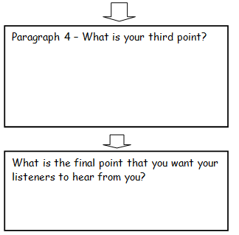
Perseverance
Resilience
Give examples like building furniture in home
Do you really want to be responsible for the downfall of Lego City? Think about all the poor, innocent and helpless citizens who will loose their homes if you choose Emmet and not me! I ask that you consider this decision carefully and know that I am ready to take on this challenge at the drop of a hat.
I look forward to hearing your decision soon and thank you for your time in listening to my speech.

