Slide 1
Moving to
Lord Williams’s School
A transition workbook for Pupils in Year 6 Term 6

Slide 2
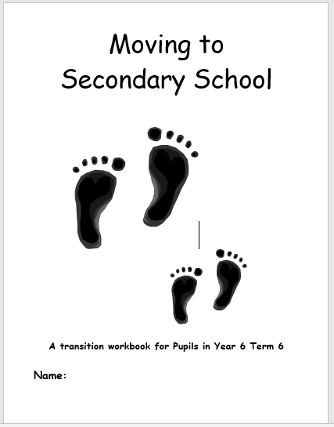
Overview for Parents
This Power point has been put together to support the activities in the Moving to Secondary booklet.
This pack was designed for pupils to be completed with a trusted adult in Year 6, Term 6 as part of a planned transition with the receiving secondary school. Information and images can be accessed on the school website or from the prospectus.
We have tried to include as much of the information you are likely to need within this power point and accompanying Moving on to Secondary Booklet.

Slide 3
Included in this pack:
You also need to obtain from secondary schools: (included)
Prospectus- that can be cut up by your students.
Map of school.
Example Timetable. (If possible)
Example Lunch Menu (If Possible.)
Students will need to bring in Ties for week 3 of the work, if they need them for Secondary.
You will need:
A4 Paper.
Glue.
Colouring pencils/pens.
Internet.
Street Map Or Google Maps.
Booklet
Worries Assessment
Mock Timetable + Visual Timetable + Questions
Mock Lunch Menu.
Secondary school vocabulary game.

Slide 4

Lesson plans
Lesson 1- You will need: Secondary school prospectus, scissors and glue. Internet
Questions about secondary.
Find out about secondary school + badge.
Worries activity
Reflecting on primary school
The aim of this session is to allow students to express any concerns about secondary school, and to find out basic information about their new school
Fill in pages 2, 3 and 4 of the booklet.
School Website: www.lordwilliams.oxon.sch.uk
School Prospectus: www.lordwilliams.oxon.sch.uk/lord-williams-school-prospectus

Slide 5
Lesson 2- You will need: Internet access, map of the local area , vocabulary resource.
Getting to school and home again
Draw or print off a map of your route
Vocabulary session- subject understanding/meanings. Card and sentence matching game.
The School day
The aim of this session is to discuss how you will get to school, the route that you will take and how long this will take you, in order to get to school on time. Look at the school day for timings and to see how it is set out.
The aim of the vocabulary game is to introduce students to a new set of subjects and meanings. Fill in pages 5, 6 and 7 of the booklet.
Vocabulary session resources on next 4 slides. (You will need to print and cut these out before use.)
School Website: www.lordwilliams.oxon.sch.uk

Slide 6
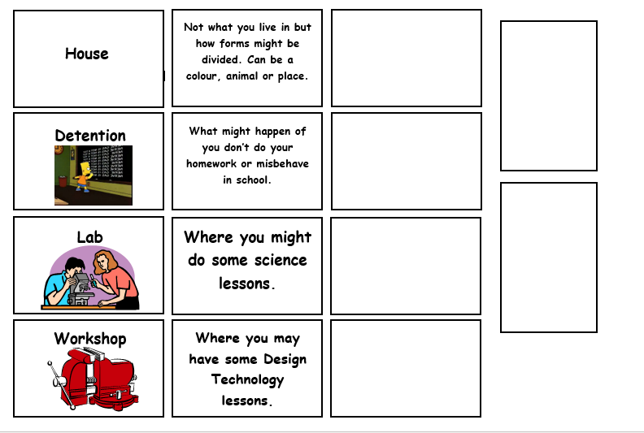
Vocabulary resource

Slide 7
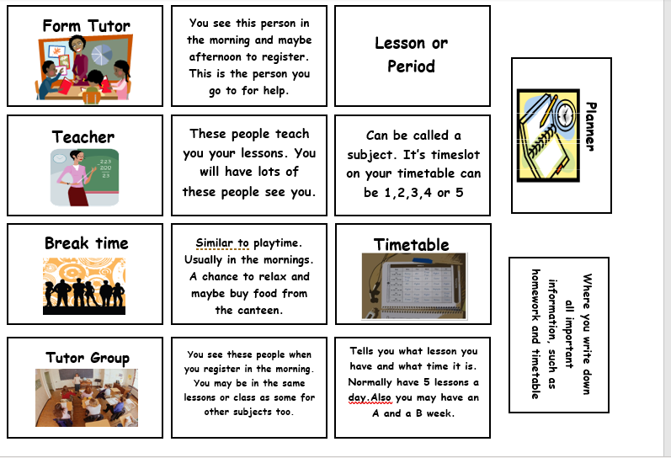

Slide 8
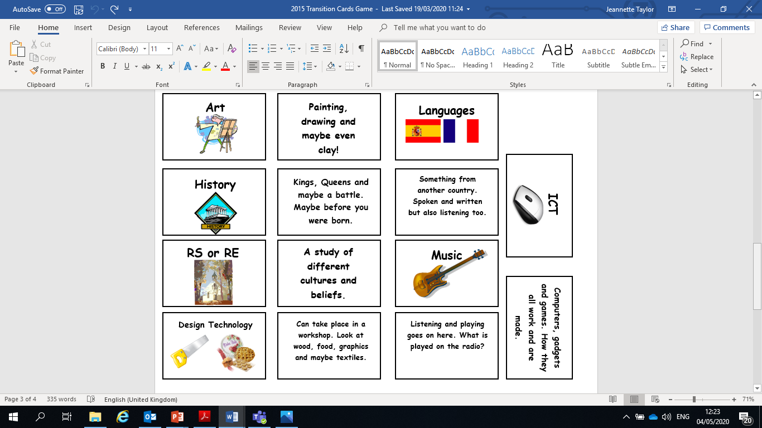

Slide 9
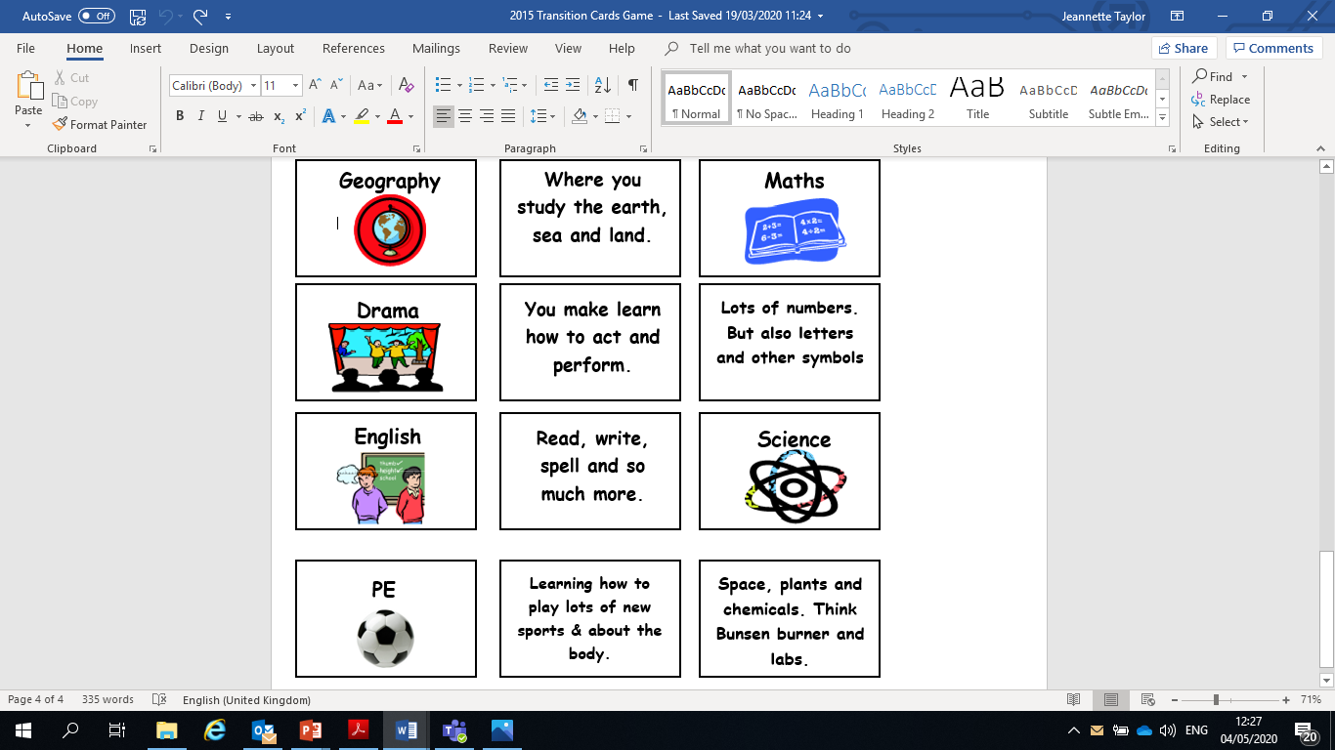

Slide 10
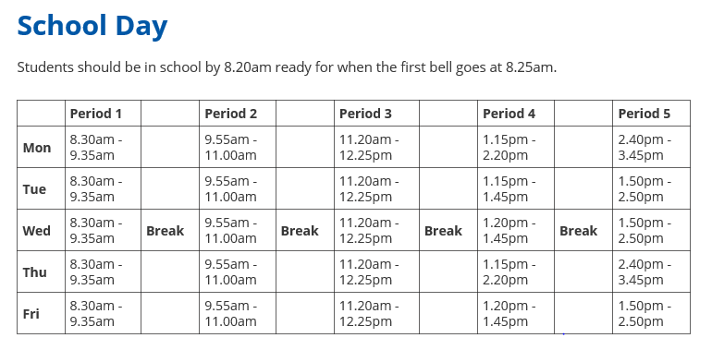

Slide 11

Lesson 3- You will need internet or school prospectus and a tie, if required to wear one.
Same and Different
School Uniform
If I need help…..
Questions you may have
The aim of this session is to determine what you feel will be the main similarities and differences between Primary and Secondary school. To look at the school uniform and discuss any other essential wear for topics such as DT. To practice tying a tie( how to leave it tied when removing it for ease and speed for PE). Students to think of any questions that they may have and to provide them with answers to the most frequently asked questions To provide information regarding getting help in different situations.
School Website: www.lordwilliams.oxon.sch.uk
School uniform: www.lordwilliams.oxon.sch.uk/uniform/2529.html

Slide 12
Lesson 4- Internet and School map
Finding out about Houses
Break and Lunchtimes
Classrooms
Packing your bag and daily checklist
The aim of the session is to help the pupils to find out about the House system in their new school and how it works. To discuss break and lunchtimes, how to pay for food and look at the similarities and differences to primary school. To discuss the difference regarding classrooms and to think about what equipment they will need in school each day.
(School map on slide 17.)
School Website: www.lordwilliams.oxon.sch.uk

Slide 13
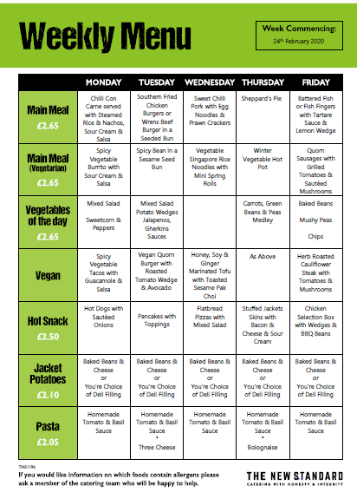

Catering
Please see the Catering page for information about menus and Free School Meals.
www.lordwilliams.oxon.sch.uk/catering-service/2521.html
Example Menus

Slide 14
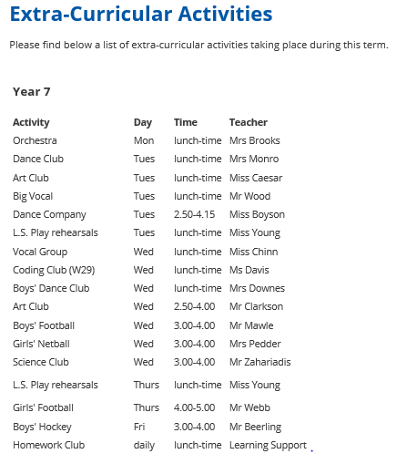
Lesson 5- You will need internet and prospectus
Teachers
Important People to know
Friends
Joining in
The focus of this session is for the pupils to look at the difference between their primary school class and teacher and those at secondary school. To identify important people in school and to look at how to make new friends . To discover new and extra- curricular activities in their secondary school and to look at which may be of interest to them.
School Website: www.lordwilliams.oxon.sch.uk
www.lordwilliams.oxon.sch.uk/extracurricular/2535.html

Slide 15
Lesson 6 – You will need a mock timetable, map of school, internet and prospectus
Lessons
Homework
Rules and detentions.
Looking forward, exciting times
The final session will focus on making sure students understand how lessons will differ,and enable them to think about the different lessons that they will have. To discuss how homework is set, how much may be given at any one time and the importance of writing it in your planner. To look at the rules in school and to discuss the different types of detention and why it is likely to be given. Finally to look forward and to discuss what they are most looking forward to in September. The session should be concluded with the worries activity to look at how worries have been allayed during the 6 week programme.
Complete remaining pages of booklet.
Map of school on next slide.
School Website: www.lordwilliams.oxon.sch.uk

Slide 17
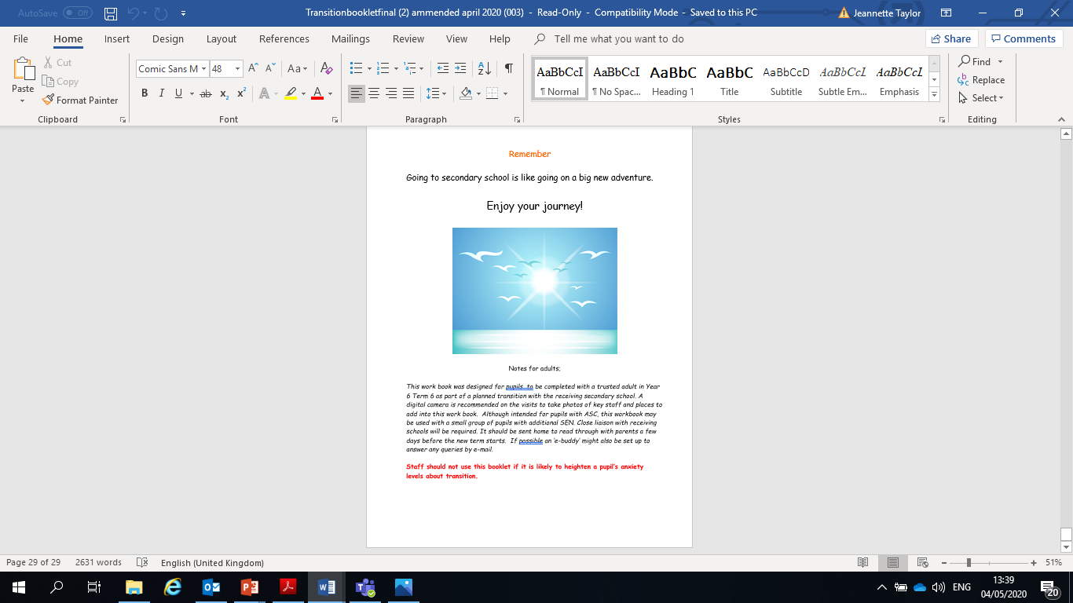

Slide 18
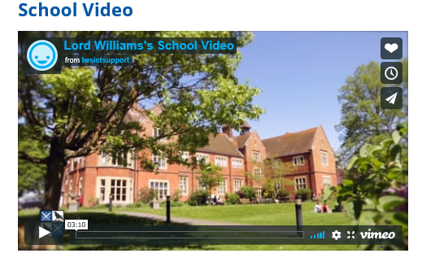
https://www.lordwilliams.oxon.sch.uk/school-video/218989.html

