Slide 1




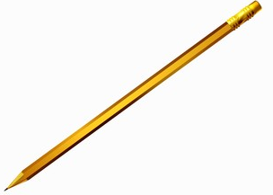

Weekly Newsletter – 24th October 2025
Stars of the Week
This week our stars are:
Y1: Theo Lewis, Harrison Evans, Lilly Gutteridge
Y2: April Cranney, Maddox Kiddimu
Y3: Grayson Watson, Finlay Richardson
Y4: Rex Allison, Oliver Boyle
Y5: Kira Wilson, Jasper Cullum
Y6: Stanley Chamlet, Molly Morgan, Jude Horner
Congratulations to Lucas Rudolph in Year 5 for receiving the Bronze Reading award.
This week I am please to be handing out a music certificate to Ruby Samuels in Year 4 who moved up a level in her piano playing.
Children in Year 4 have been working very hard on their handwriting, and I am pleased to say the following children have received their golden pencil:
Violet Harper, Lucy Milne, Mason Gatial, Freddie Milne, Lyla Gutteridge
Finally, the following children passed their Level 2 cycling proficiency test in Year 6: Sienna Richards, Charlotte Tanner, Jamie Rockall, Oli Sears.

