Slide 1
Progression in Calculation
September 2022

Slide 2
Early Years
Maths for young children should be meaningful. Where possible, concepts should be taught in the context of real-life.
Children must be exposed to different representations of mathematical concepts in order to embed conceptual understanding. Children are encouraged to make links, find new ways to do things, solve problems, change strategies as needed, make predictions and develop ideas of grouping, sequencing, cause and effect.
By the end of the reception year children are expected to reach the Early Learning Goal (ELG) outlined below:
Number ELG
Children at the expected level of development will:
Have a deep understanding of number to 10, including the composition of each number
Subitise (recognise quantities without counting) up to 5
Automatically recall (without reference to rhymes, counting or other aids) number bonds up to 5 (including subtraction facts) and some number bonds to 10, including double facts.
Numerical Patterns ELG
Children at the expected level of development will:
Verbally count beyond 20, recognising the pattern of the counting system
Compare quantities up to 10 in different contexts, recognising when one quantity is greater than, less than or the same as the other quantity
Explore and represent patterns within numbers up to 10, including evens and odds, double facts and how quantities can be distributed equally.

Slide 3
Addition
Vocabulary:
Games and songs to begin using vocabulary involving addition.
Add, more, and, make, total, altogether, double, one more, two more, how many more, equals.
Nursery children focus on: Counting songs, counting rhymes, counting real objects, counting people, how many altogether, counting then saying the total, counting 1:1 correspondence, real life adding eg apples at snack time, milk, girls and boys.

Slide 4
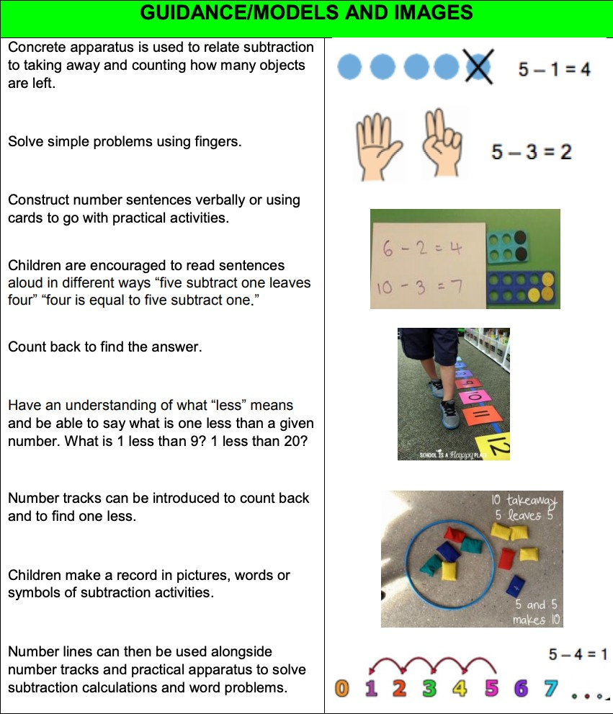
Subtraction
Vocabulary:
Take away, leave, how many are left, how many have gone, one less, two less, is the same as.
Nursery children focus on: Counting songs, counting rhymes, counting real objects, using language associated with less, counting people, counting 1:1 correspondence, real life subtraction eg apples at snack time, milk, girls and boys, take away, identifying when totals are the same.

Slide 5
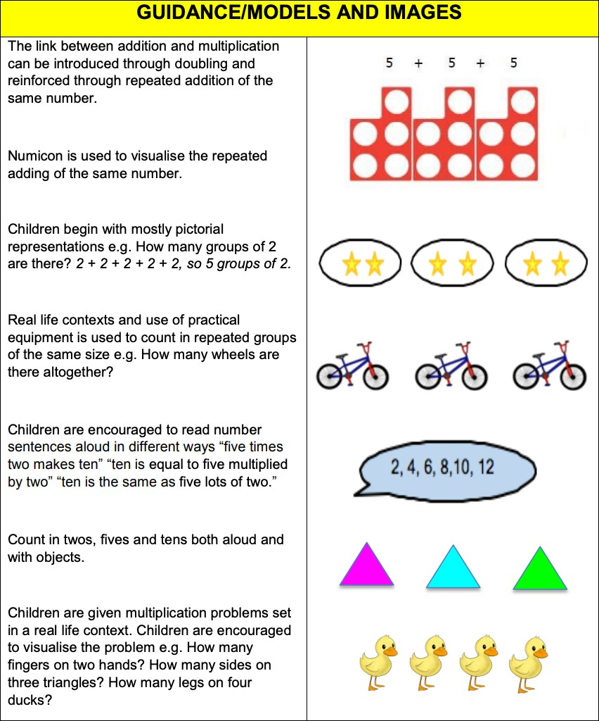
Multiplication
Vocabulary:
Lots of, groups of, double.
Nursery children focus on: counting groups of, groups of same numbers, pairs of objects, sets of objects.

Slide 6
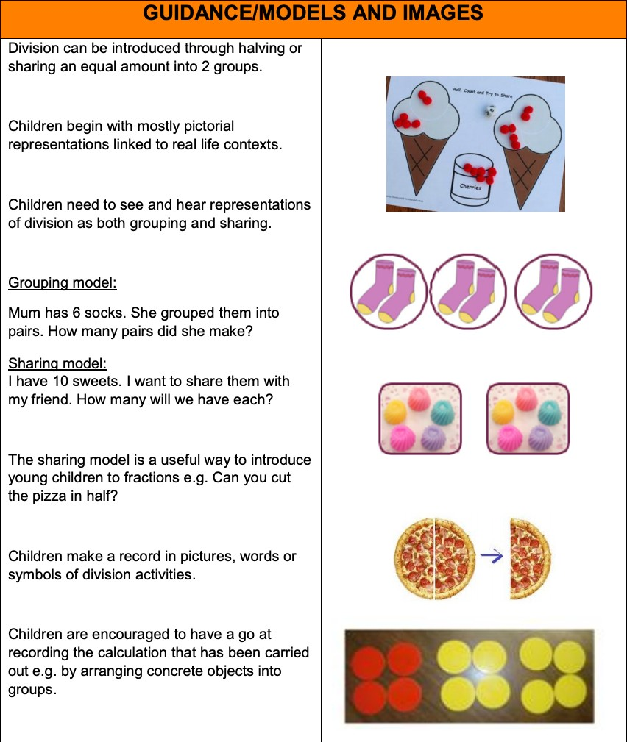
Division
Vocabulary:
Half, halve, equal, groups of.
Nursery children focus on: Sharing, halving, equals

Slide 7
Aims
The national curriculum for mathematics aims to ensure that all pupils:
become fluent in the fundamentals of mathematics, including through varied and frequent practice with increasingly complex problems over time, so that pupils develop conceptual understanding and the ability to recall and apply knowledge rapidly and accurately.
reason mathematically by following a line of enquiry, conjecturing relationships and generalisations, and developing an argument, justification or proof using mathematical language
can solve problems by applying their mathematics to a variety of routine and non-routine problems with increasing sophistication, including breaking down problems into a series of simpler steps and persevering in seeking solutions.

Slide 8
Introduction
Written methods of calculations are based on mental strategies. Each of the four operations builds on mental skills which provide the foundation for jottings and informal written methods of recording. Skills need to be taught, practised and reviewed constantly. These skills lead on to more formal written methods of calculation.
Strategies for calculation need to be represented by models and images to support, develop and secure understanding. This, in turn, builds fluency. When teaching a new strategy it is important to start with numbers that the child can easily manipulate so that they can understand the methodology.
The transition between stages should not be hurried as not all children will be ready to move on to the next stage at the same time, therefore the progression in this document is outlined in stages. Previous stages may need to be revisited to consolidate understanding when introducing a new strategy.
A sound understanding of the number system is essential for children to carry
out calculations efficiently and accurately.

Slide 9
Magnitude of Calculations
Year 1 – U + U, U + TU (numbers up to 20) including adding zero, U – U, TU – U (numbers up to 20) including subtracting zero, U x U, U ÷ U
Year 2 - TU + U, TU + multiples of 10, TU + TU, U + U + U, TU - U, TU – tens, TU – TU, TU x U, U ÷ U
Year 3 – add numbers with up to three-digits, HTU + multiples of 10, HTU + multiples of 100, subtract numbers up to three-digits, HTU – U, HTU – multiples of 10, HTU – multiples of 100, HTU – HTU,
TU x U, TU ÷ U
Year 4 - add and subtract numbers with up to four-digits, ThHTU + ThHTU, ThHTU - ThHTU, add and subtract decimals with up to two decimal places in the context of money, multiply three numbers together, TU x U, HTU x U, TU x U, multiply by zero and one, TU ÷ U, HTU ÷ U
Year 5 – add and subtract numbers with more than four-digits, add and subtract decimals with
up to three decimal places, ThHTU x U, ThHTU x TU, HTU x TU, multiply whole numbers and decimals with up to three-decimal places by 10, 100 and 1000, divide numbers with up to four-digits by U (including remainders as fractions and decimals and rounding according to the context)
Year 6 - add and subtract numbers with more than four-digits, add and subtract decimals with up to three decimal places, multiply numbers with up to four-digits by TU, multiply numbers with up to
two-decimal places by a whole number, divide numbers up to four-digits by TU (interpreting remainder
according to the context), divide decimals up to two-decimal places by U or TU

Slide 10
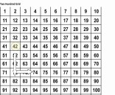
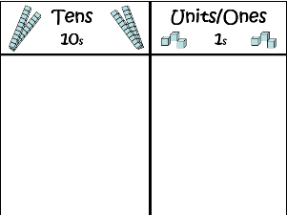
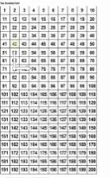
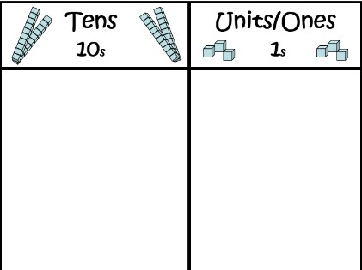
Addition
Pupils develop the concept of addition and subtraction and are enabled to use these operations flexibly.
Addition and subtraction should be taught together.
End of Year Expectations
Possible Concrete and Visual Representations
Children’s Recording
Fluency
Year 1
0 | 1 | 2 | 3 | 4 | 5 | 6 | 7 | 8 | 9 | 10
If using Numicon, children could use printed Numicon icons and stick these in - progressing to recording number sentences alongside
4 + 2
+2
two more than four
6 8 10 12 14 16 18
Count forwards, to and across 100, beginning with 0 or 1 or from any given number
Switch count between tens and ones e.g. 10, 20, 30,
31, 32, 33 …
Represent and use number bonds up to 20 (establish addition and subtraction as related operations)
Find one more than a number Find ten more than a number
Count in multiples of 2s, 5s and 10s starting on multiples to highlight pattern recognition
Children must experience combining two, and then more than two, groups of objects using counting on and the language of addition e.g. add, plus
0
2
4
+
+ 2
=
=
1
3
Example
Children must experience increasing numbers e.g. what is two more than seven ?
‘two more than three is five or two less than five is three’
Children may record pictorially progressing to recording number sentences alongside
Compare quantities to say how many less and/or how many more
9 + 6
Use practical resources such as bears, counters, cubes and number lines/hundred grids and progress to a resource such as Numicon to encourage counting in groups rather than ones
6 7 8 9 10 11 12 13 14 15 16
Year 2
Cuisenaire
Children apply, develop and secure their understanding of place value
Children should be able to partition numbers in different ways e.g. as 2+2+2+1 or 5+3 or 23 as 20 +3 or 10+13
?
Use jottings and record number sentences
?
7 | 3
41
+ 28
Show increasing fluency in deriving pairs of numbers up to 10 and then up to 20
Use knowledge to derive and use number facts up to 100
Add numbers mentally including TU + U, TU + tens, TU + TU, U + U + U
Children should use concrete objects, pictorial representations and add numbers in different contexts e.g. money, measures
20
2
Bar Model
ENSURE CHILDREN HAVE THE OPPORTUNITY TO ADD MORE THAN TWO NUMBERS
0 5 10 15 20 25 30 35 40 45
Numbered and partially numbered number lines
40
+ 20
= 60
1
+ 8
= 9
Children should understand the language of sum
Ensure children understand that addition is commutative (can be done in any order)
Use Numicon, number grids, place value apparatus/Dienes, place value grids, place value cards, Encourage children to partition numbers rather than counting in ones.
60 + 9 = 69

Slide 11
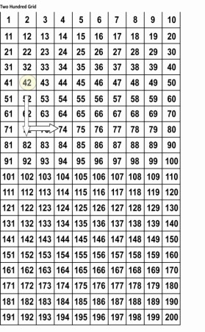
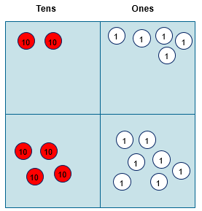
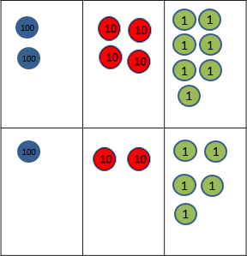
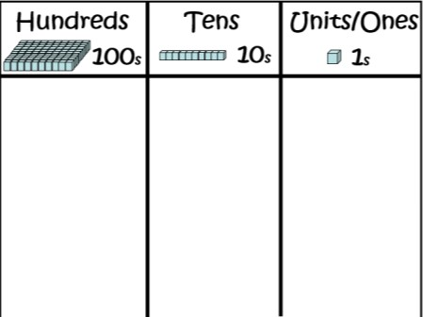
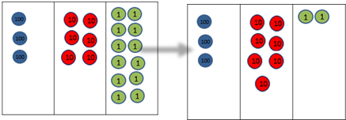
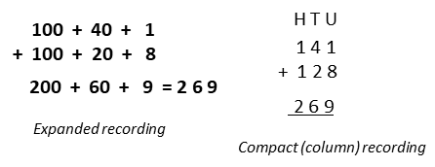
End of Year Expectations
Possible Concrete and Visual Representations
Teacher Modelling/Children’s Recording
Fluency
Year 3
Children apply, develop and secure their understanding
of place value and begin to record in columns
Add numbers with up to three-digits (leading to formal written column method)
Manipulatives such as Dienes and Place value counters SHOULD be used alongside written methods
Count in ones, tens and hundreds maintaining fluency through varied and frequent practice
Introduce expanded column addition modelled with place value counters (Dienes could be used for those who need a less abstract representation)
ENSURE CHILDREN HAVE THE OPPORTUNITY TO ADD MORE
THAN TWO NUMBERS WITH
DIFFERING NUMBERS OF DIGITS
Count from 0 in multiples of 4, 8, 50 and 100
Find 10 or 100 more than a number
Children should partition numbers,
up to 1000, in different ways
e.g. 100 + 40 + 6 or 100 + 30 + 16
Leading to children understanding the exchange between tens and ones.
Some children may begin to use a formal columnar algorithm, initially introduced alongside the expanded method. The formal method should be seen as a more streamlined version of the expanded method, not a new method.
Mentally add HTU
+ ones, HTU + tens, HTU + hundreds
Perform mental calculations with two- digit numbers, the answer could exceed 100
Solve problems in different contexts including missing number problems
Year 4
Column addition (no exchanging) with up to three-digits
+ | 4 0 2 0 | + + | 1 8 | 4 0 + 3 2 0 + 8
 | 6 0 | + | 9 = 6 9 | 7 0 + 1 | = 7 1
Add numbers with up to four- digits (formal written column method) including numbers with up to two decimal places in the context of money
100
10
1 1
1
Count in 6s, 7s, 9s, 25s and 100s
100
10
3
Find 1000 more than a number
ENSURE CHILDREN HAVE THE OPPORTUNITY TO ADD MORE THAN TWO NUMBERS INCLUDING DECIMALS, WITH DIFFERING NUMBERS OF DIGITS
Perform mental calculations with increasingly large numbers to aid fluency
Solve two-step problems in different contexts including missing number problems
⁰ 10 20 30 40 50
Partially numbered and blank number lines
?
?
70 | 30
7
Cuisenaire
Bar Model

Slide 12
Addition
Pupils develop the concept of addition and subtraction and are enabled to use these operations flexibly.
Addition and subtraction should be taught together.
End of Year Expectations
Possible Concrete and Visual Representations
Teacher Modelling/Children’s Recording
Fluency
Year 5
0.01 | 0.02 | 0.03 | 0.04 | 0.05 | 0.06 | 0.07 | 0.08 | 0.09
0.1 | 0.2 | 0.3 | 0.4 | 0.5 | 0.6 | 0.7 | 0.8 | 0.9
1 | 2 | 3 | 4 | 5 | 6 | 7 | 8 | 9
Manipulatives such as Place value counters SHOULD be used alongside algortihms
Add numbers with more than four-digits and decimals up to three places
(formal written column method)
Count forwards in powers of ten up to 100000
U
1/10
1/100
2 1. 4 1
+ 1. 1 2
0. 3 5
Count forwards in positive and negative whole numbers through zero
N.B. ENSURE CHILDREN HAVE THE OPPORTUNITY TO ADD MORE THAN TWO NUMBERS INCLUDING DECIMALS, WITH
DIFFERING NUMBERS OF DIGITS
2 1 4 1
+ 1 1 2 8
3 2 6 9
Practise mental calculations with increasingly large numbers
2 2. 8 8
Solve multi-step problems selecting and justifying methods
1
0.1
0.01
Column addition (no exchanging)
Practise fluency of written methods
Perform mental calculations with
increasingly large numbers
1
0.1
0.01
Cuisenaire
Year 6
?
5 1 8 9
+ 3 1 2 8
5 1. 8 9
+ 3. 1 2 8
Add numbers with more than four-digits and decimals up to three places
(formal written column method)
N.B. ENSURE CHILDREN HAVE THE OPPORTUNITY TO ADD MORE THAN TWO NUMBERS, INCLUDING DECIMALS, WITH
DIFFERING NUMBERS OF DIGITS
Solve more complex calculations mentally
Bar Model
5 5. 0 1 8
1 1
Count in tens and hundreds increasing fluency of order and place value
8 3 1 7
?
0.7 | 0.3
1 1
Perform increasingly complex mental calculations and those with increasingly large numbers to aid fluency
Column addition (with exchanging)
Solve multi-step problems in contexts, deciding which operations and methods to use and why
Addition with decimals up to three decimal places including in different contexts e.g. money and measures
0 0.1 ^{0.2} 0.3 0.4 0.5
Partially numbered and blank number lines

Slide 13
Subtraction
Pupils develop the concept of addition and subtraction and are enabled to use these operations flexibly.
Addition and subtraction should be taught together.
End of Year Expectations
Possible Concrete and Visual Representations
Children’s Recording
Fluency
Year 1
0 | 1 | 2 | 3 | 4 | 5 | 6 | 7 | 8 | 9 | 10
Children may begin recording pictorially progressing to recording number sentences alongside
5 - 3
0 1 2 3 4 5 6 7 8 9 10
Count backwards (including crossing 100) any given number
Switch count between ones and tens e.g. 33, 32, 31, 30, 20, 10
Represent and use subtraction facts linked to number bonds up to 20 (establish addition and subtraction as related operations)
Find one less than a number Find ten less than a number
Count back in multiples of 2s, 5s and 10s starting on multiples to highlight pattern
Understand subtraction as taking away
What is … less than …?)
Exam
ple
-1 -1
‘two less than five is three’
Compare quantities to say how many less and/or how many more
0 1 2 3 4 5 6 7 8 9 10
Children could use printed Numicon icons and stick these in, again progressing to recording number sentences alongside
Use practical resources such as bears, counters, cubes and number lines/hundred grids and progress to a resource such as Numicon to encourage counting back in groups rather than ones
Year 2
10 - 4
Finding the difference
Children apply, develop and secure their understanding of place value and begin to record using jottings and number sentences
Children should use concrete materials and pictorial representations, and use numbers in different contexts e,g, money and measures, Encourage children to partition numbers rather than counting in ones.
Practise addition and subtraction facts to 20
Show increasing fluency in deriving subtraction facts for numbers up to 10 and then up to 20
Use known facts to 20 to derive new facts e.g. 3 + 7 – 30 + 70
Use knowledge to derive and use subtraction number facts up to 100
Understand subtraction as taking away
and finding the difference
16 - 3
no exchanging
Ensure children understand that subtraction is not commutative (can not be done in any order)
Children should be able to partition numbers in different ways
20
2
0 10 20 30 40 50 60 70 80 90
Numbered and partially numbered number lines
26 - 8
exchange ten for ten ones
exchanging
Cuisenaire Bar Model
10
?
7
?

Slide 14
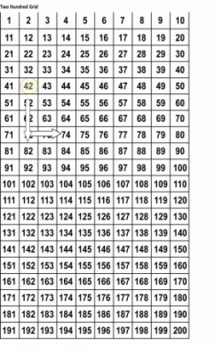
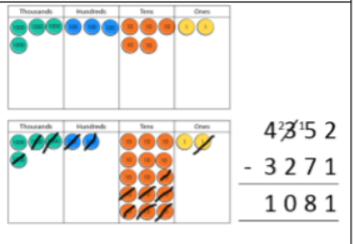
Subtraction
Pupils develop the concept of addition and subtraction and are enabled to use these operations flexibly.
Addition and subtraction should be taught together.
End of Year Expectations
Possible Concrete and Visual Representations
Teacher Modelling/ Children’s Recording
Fluency
Year 3
Cuisenaire
Children SHOULD use manipulatives alongside algorithms
to transition between practical and abstract
?
Count back in ones, tens and hundreds maintaining fluency through varied and frequent practice
Switch count between hundreds, tens and ones
e.g 500, 400, 300, 290, 280,
270, 269, 268, 267
Column subtraction (No exchange and with exchange)
Subtract numbers with up to three-digits
(formal written column method)
Children apply, develop and secure their understanding of place value and begin to record in columns
Bar Model
100
? | 30
7
Mentally subtract HTU + ones, HTU + tens, HTU + hundreds
Perform mental calculations with two-digit numbers
Find ten and a hundred less than a number with up to three-digits
Year 4
100
10
1
1
Column subtraction (with exchange)
Count back in 6, 7, 9,
25 and 1000
1
3
Count back through zero to include negative numbers
Subtract numbers with up to four-digits
(formal written column method)
Understand subtraction as the inverse of addition
Solve two-step problems deciding upon the appropriate operations and methods and justifying choices made
1 1
7 2 3
- 3 1 7
4 0 6
100
10
723 -317
Find 1000 less than a number
6 11 1
7 2 3
6 11 1
£7 . 2 3
Continue to practise mental calculations with increasingly large numbers to aid fluency
723 -367
- 3 6 7
3 5 6
- £3 . 6 7
£3 . 5 6
0
10
20
30
40
50
Ensure children can solve calculations where zero is a place holder

Slide 15
Subtraction
Pupils develop the concept of addition and subtraction and are enabled to use these operations flexibly.
Addition and subtraction should be taught together.
End of Year Expectations
Possible Concrete and Visual Representations
Teacher Modelling/ Children’s Recording
Fluency
Year 5
0.01 | 0.02 | 0.03 | 0.04 | 0.05 | 0.06 | 0.07 | 0.08 | 0.09
0.1 | 0.2 | 0.3 | 0.4 | 0.5 | 0.6 | 0.7 | 0.8 | 0.9
1 | 2 | 3 | 4 | 5 | 6 | 7 | 8 | 9
Children might use manipulatives alongside algorithms
Column subtraction (no exchanging)
1 3 5 4 8
- 1 2 1 2 8
1 4 2 0
Subtract larger numbers (formal written column method)
Count backwards in powers of ten up to one million
Count backwards in positive and negative whole numbers through zero
Practise mental calculations with increasingly large numbers
N.B. ENSURE CHILDREN HAVE THE OPPORTUNITY TO SUBTRACT
DECIMALS WITH DIFFERING NUMBERS OF DIGITS
U
1/10
1/100
2 13 11 1
Column subtraction (with exchanging)
1 3 4 2 3
- 1 2 6 7 8
7 4 5
Solve multi-step problems selecting and justifying methods
Subtract numbers mentally with increasingly large numbers
1
0.1
0.01
1
0.1
Cuisenaire
Ensure children can solve calculations where zero is a place holder
0.01
Year 6
?
1 . 4 8
- 1 . 2 1
Column subtraction (no exchanging)
Subtract multi-digit numbers including numbers with up to three decimal places
(formal written column method) ENSURE CHILDREN HAVE THE
OPPORTUNITY TO SUBTRACT DECIMALS,
WITH DIFFERING NUMBERS OF DIGITS
0. 2 7
1
? | 0.3
Undertake mental calculations with increasingly large numbers and more complex calculations
Bar Model
6 11 1
7 . 2 3
Solve multi-step problems in contexts, deciding which operations and methods to use and why
Column subtraction (with exchanging)
- 3 . 6 7
3 . 5 6
Solve more complex calculations mentally
0
0.1
0.2
0.3
0.4
0.5
Subtraction with decimals up to three decimal places including in different contexts e.g. money and measures

Slide 16
Multiplication
Pupils develop the concept of multiplication and division and are enabled to use these operations flexibly.
Multiplication and division should be taught together.
End of Year Expectations
Possible concrete and visual representation
Children’s Recording
Fluency
Year 1
Practical only e.g. link to small world Using concrete objects, pictorial
representations and arrays with the support of an adult – take photographs/draw pictures – if using Numicon small icons could be stuck in
Count in twos, fives and tens from different multiples
e.g. 6, 8, 10, 12 etc Emphasise number
patterns
Double number and quantities
Solve single step practical problems involving multiplication
Use concrete objects, pictorial representations to explore grouping
counting in twos
four lots of two is eight
two lots of four is eight
Make connections between arrays, number patterns and counting in twos, fives and tens
arrays- Numicon, Cuisenaire, counters
0 2 4 6 8
Double numbers and quantities
track with cuisenaire
flexible array
Year 2
Record practical work as number sentences
4 x 2 = 8
2 x 4 = 8
Count in twos, threes, fives from zero and tens from any number
e.g. 6, 8, 10, 12 etc Emphasise number patterns
Understand multiplication as repeated addition
2 + 2 + 2 + 2 = 4 x 2
two add two add two add two add two
= four lots of two
0 2 4 6 8
Calculate mathematical statements for multiplication within the tables and write them using symbols
Understand and solve problems involving arrays
Introduction to multiplication tables. Practise to become fluent in multiplication facts for 2, 5 and 10
Solve multiplication problems mentally
Ensure children understand that multiplication is commutative (can be done in any order)
Understand that multiplication and division are inverse operations
flexible array
0 2 4 6 8
5
10
15

Slide 17
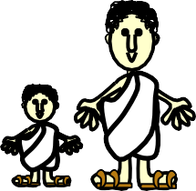
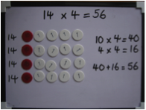
Multiplication – multiplication and division should be taught together
End of Year Expectations
Possible concrete and visual representation
Teacher Modelling/Children’s Recording Fluency
Children must use manipulatives alongside algorithms
Year 3
Cuisenaire to
represent scaling
Statue is 3 times as tall: 3 metres
4 x 13 ‘four lots of thirteen’
10 3
Count from 0 in multiples of 4, 8,
50 and 100
Use multiples of 2, 3, 4, 5, 8, 10,
50 and 100
Practise mental recall of multiplication tables – 3, 4 and 8x times tables
Connect the 2, 4 and 8 times tables using doubling
Develop efficient mental methods using commutativity and multiplication facts to derive related facts e.g. 4 x 4 x 12 = 12 x
4 x 5 = 12 x 20
Develop reliable written
methods
I am 1 metre tall
4
Understand and solve scaling problems
Solve problems involving multiplication including correspondence
flexible array
Year 4
arrays
4 x 13
Count in multiples of 6, 7, 9, 25
and 1000
Recall and use multiplication facts up to 12 x 12 with increasing fluency
Derive multiplication facts with up to three-digits
Recognise and use factor pairs and commutativity in mental calculations
Use the distributive law
Combine knowledge of number facts and rules of arithmetic to solve mental and written calculations e.g. 2 x 6 x 5 = 10 x 6
Multiplying three numbers Solve two-step problems Multiplying by 0 and by 1
Develop fluency in short multiplication using formal written layout
Solve problems involving multiplication including using the distributive law, integer scaling problems and harder correspondence problems
Progressing to developing fluency in short multiplication
1 1
1 1
1 1
₁ 1
1 3 1 3 3
x 4 x 4
5 2 5 3 2
1 1
10
10
1
1
1
1
place value counters
10
10
?
1
20 | 20 | 20 | 20
?
Start with digits that are below five so children can practise method without encountering difficulty with multiplication tables
bar models

Slide 18
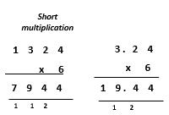
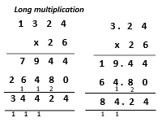
Multiplication - multiplication and division should be taught together
End of Year Expectations
Possible concrete and visual representation
Teacher Modelling/Children’s Recording Fluency
Children might use manipulatives alongside algorithms
Year 5
Cuisenaire to represent scaling
Statue is 3 times as tall: 3 metres
Multiply decimals with up to three decimal places
I am 1 metre tall
Count forwards in steps of powers of 10 from any given number up to
1 000 000
Practise and extend use of formal written method of short multiplication
Apply all multiplication tables frequently. Commit them to memory and use them confidently to make larger calculations
Multiply numbers mentally drawing upon known facts
Identify multiples and factors including finding all factor pairs of a number, and common factors of two numbers
Solve problems involving all four operations where larger numbers are used by decomposing them into their factors
Multiply whole numbers and those involving decimals by 10, 100 & 1000
Understand and use multiplication and division as inverses including in problems involving missing numbers and balancing equations
Solve problems involving multiplication and division including scaling by simple fractions
Know and use the vocabulary of prime numbers, prime factors and composite (non-prime)
Recognise and square and cube numbers and associated notation
flexible array
4 x 13
4 x 23
arrays
Year 6
0.1
0.1
0.01
0.01
0.01
0.1
0.1
0.01 0.01 0.01
Undertake mental calculations with increasingly large numbers
Continue to use all multiplication tables to calculate mathematical statements in order to maintain fluency
Multiply numbers up to 4-digit x TU
place value counters
0.01
0.01 0.01
Multiply numbers with up to two decimal places x whole number
0.01 0.01 0.01
Multiply multi-digit numbers up to four- digits by a two-digit whole number
Multiply single –digit numbers with up to
two-decimal places by whole numbers
Solve problems involving all four operations
?
0.2 | 0.2 | 0.2 | 0.2
?
bar models

Slide 19
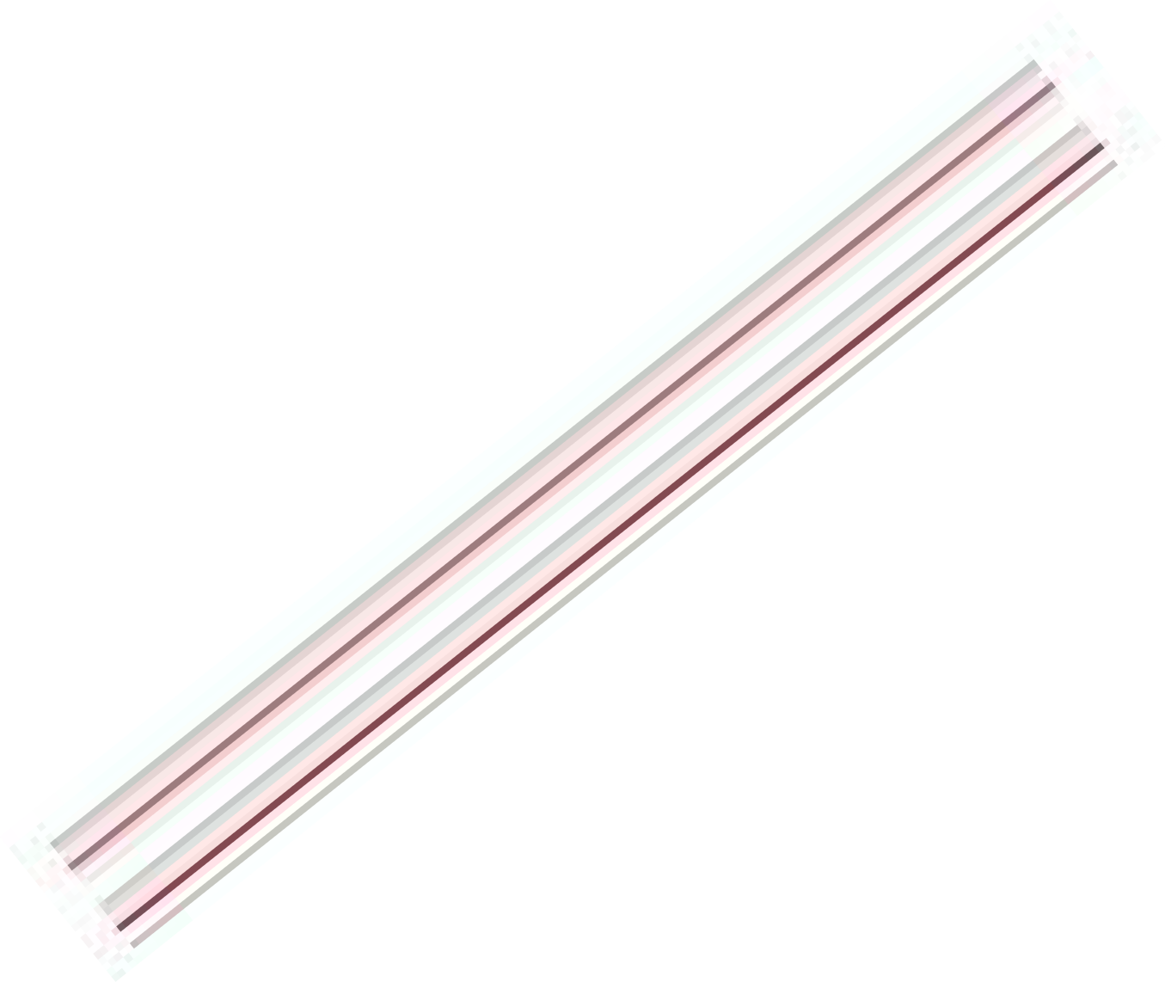
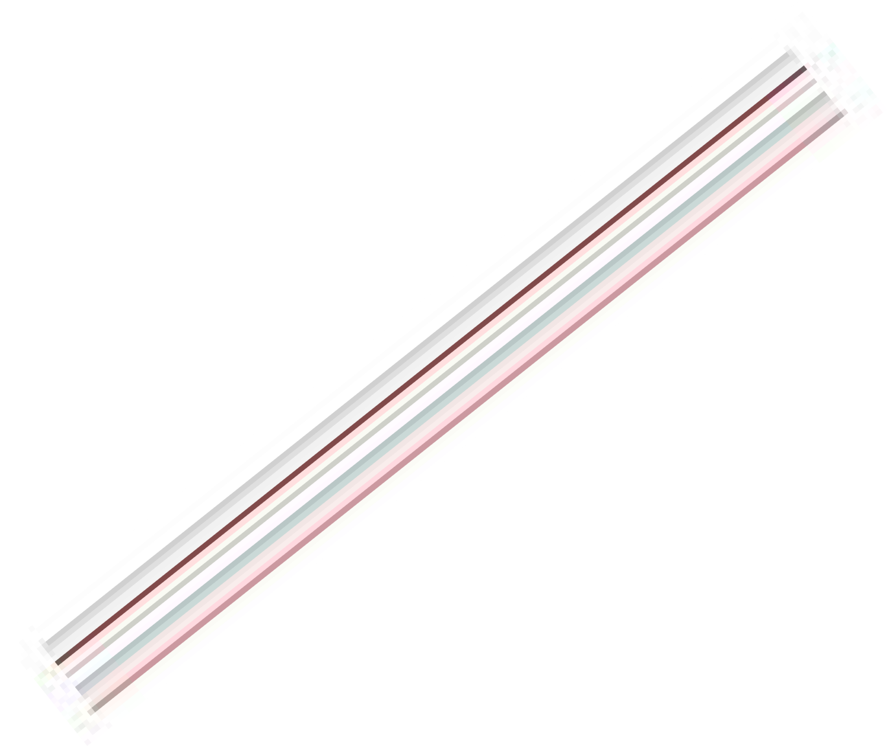
Division
Pupils develop the concept of multiplication and division and are enabled to use these operations flexibly.
Multiplication and division should be taught together.
End of Year Expectations
Possible concrete and visual representation
Teacher Modelling/Children’s Recording
Fluency
Year 1
counting in groups of twos
Practical only e.g. link to small world Using concrete objects, pictorial
representations and arrays with the support of an adult – take photographs/draw pictures – if using Numicon small icons could be stuck in
Count in twos, fives and tens from different multiples
e.g. 6, 8, 10, 12 etc
Emphasise patterns
Solve single step practical problems involving division
Use concrete objects, pictorial representations
straw bundles
Understand division as grouping and sharing
Eight can be divided into four equal groups of two or two equal groups of four
Find simple fractions eg half and quarter, of objects, numbers and quantities
Use the language of ‘sharing equally between’
four lots of two
Numicon and counter arrays
Year 2
Record as number sentences using ÷ and =
8 ÷ 4
Eight divided into four equal groups = two in each group
Cuisenaire
Count back in twos, threes, fives from zero and tens from any number
e.g. 12, 10, 8, 6 etc Emphasise patterns
Connect ten times table to place value and five times table to divisions on a clock face
Solve single step practical problems
involving division
Use concrete objects, pictorial representations
Understand division as grouping
four lots of two
two lots of four
doubling
Find halves and then quarters
Eight can be divided into four equal groups of two or two equal groups of four
Work with a range of materials and contexts in which multiplication and division relate to grouping and sharing discrete quantities and to arrays
Introduction to multiplication tables. Practise to become fluent in division facts for 2, 5 and 10
Solve division problems involving grouping and sharing
flexible array
? | ? | ? | ?
bar models
? ? ₈ ? ?

Slide 20
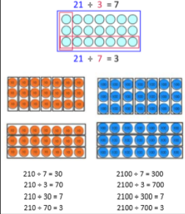
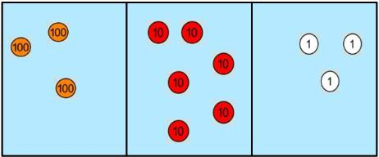
Division - multiplication and division should be taught together
End of Year Expectations
Possible concrete and visual representation
Teacher Modelling/Children’s Recording
Fluency
Year 3
Cuisenaire to Statue is 3 metres
represent scaling
Children should use manipulatives alongside algorithms
Pupils use their growing knowledge of multiplication facts, place value and derived facts to multiply mentally
Develop a reliable written method for division
Solve problems involving missing numbers
Solve problems including those
that involve scaling
Recognise, find and name ½ and ¼ of an object, shape or quantity
Understand the link between unit fractions and division
I am 3 times smaller
Recall and use related division facts for the 3, 4 and 8x tables (Continue to practise other tables)
Write and calculate mathematical statements for division using what is known
Use division facts to derive related division facts e.g. using 6 ÷ 3 = 2 to work out 60 ÷ 3 = 20
Connect 1/10 to division by 10 Count in tenths
arrays
Year 4
88 ÷ 4
÷
2
2
Become fluent in the formal written method of short division with exact answers when dividing by a one-digit number
Divide one- or two-digit numbers by 10 or 100, identifying value of digits as tenths or hundredths
Solve two-step problems in different contexts, choosing the appropriate operation, working with increasingly harder numbers including correspondence questions e.g. three cakes shared equally between 10 children
Continue to practise recalling division facts for multiplication tables up to 12 x 12
Practise mental methods and extend this to three-digit numbers for example 200 x 3 = 600 into 600 ÷ 3 = 200
Use place value, known and derived facts to divide mentally, including dividing by 1
Recognise and use factor pairs and commutativity in mental calculations
4
10
10
1
1
1
10
10
1
÷ | 1 | 2 | 1
3 | 3 | 6 | 3
10 10
1
1
1
10
10
1
? | ? | ? | ?
321 ÷ 3
Short division- no remainders
÷
1 4 0
? | ? | ? | ?
80
560 ÷ 4
4 5 ¹ 6 0
bar models

Slide 21
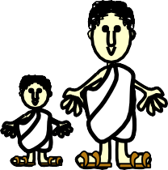
Division - multiplication and division should be taught together
End of Year Expectations
Possible concrete and visual representation
Teacher Modelling/Children’s Recording
Fluency
Year 5
Children might use manipulatives alongside algorithms
Cuisenaire to
represent scaling
Statue is 3 metres
without remainder
560 ÷ 4
1 4 0
short division
Identify factors , including finding all factor pairs of a number, and common factors of two numbers
Practise and extend the formal written method of short division: numbers up to four-digits by a one- digit number
Interpret non-integer answers to division by expressing results in different ways according to the context, including with remainders, as fractions, as decimals or by rounding as appropriate for the context
Use multiplication and division as
inverses
Solve problems involving division including scaling down
564 ÷ 5
1 1 2 . 8
Count backwards in steps of powers of 10 for any given number up
to 1 000 000
Count backwards with positive/negative whole numbers through zero
Practise mental calculation with increasingly large numbers
Apply all multiplication tables and related division facts frequently, commit them to memory and use them to confidently to make larger calculations
I am 3 times smaller
remainder as a decimal
5 5 6 ¹4 ⁴. 0
1
4 5 6 0
1 1 2
2/5
1
remainder as a fraction
5 5 6 4
flexible arrays
Long division using multiples
4.8 ÷ 4
Divide whole numbers and those involving decimals by 10, 100 & 1000
÷
1
.
2
13
10
7
Year 6
1
1
0.1
0.1
Divide numbers up to 4-digits by a 2- digit whole number using formal written methods of long division, interpret remainders as whole numbers, fractions or by rounding, as appropriate for the context
Divide numbers with up to 2 decimal places by 1-digit and 2-digit whole numbers, initially in practical contexts involving money and measures
Understand the relationship between unit fractions and division
Recognise division calculations as the inverse of multiplication
Solve problems involving division
4
1
1
0.1
Practise division for larger numbers, using the formal written methods of short and long division
Continue to use all multiplication tables and division facts to maintain fluency
Perform mental calculations, including with mixed operations and larger numbers
0.1
24 x 5 = 120 R10
24 x 4 = 96 R7
24 x 3 = 72
4
0.1
0.1
0.1
0.1
0.8
? | ? | ? | ?
? | ? | ? | ?
0.8
bar models

