Slide 1
Year 6 Teams Meeting
English Transition Work

Slide 2
You need to persuade us that YOU are the special one and not Emmet.
Emmet is an ordinary man who lives his life according to a set of instructions.
His only creative thought is for a double-decker sofa.
You need to outline what makes you more special than Emmet.
You need to focus especially on what makes you more of a creative builder!
What could you build with all of the pieces of Lego in the world
(can you beat a double-decker sofa)?

Slide 4
Emmet
Clumsy
Unimaginative (follows the crowd)
Not athletic
Enthusiastic
Immature
ordinary

Slide 5
You
Resilient
Experience building
Persevere
Hard-working
Committed/dedicated
Creative

Slide 6
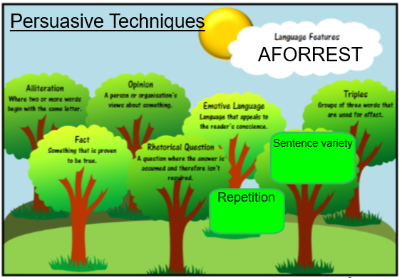

Slide 7
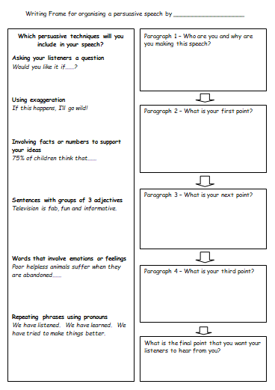

Slide 8
Do you really want to be responsible for the downfall of LEGO City?
I am the number 1 builder and creative thinker in the whole world!
99% of the LEGO City population agree that I am the most suited for the job.

Slide 9
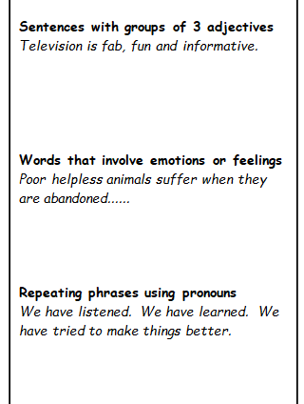
I am an enthusiastic, creative and hardworking member of Lego City, who would love the opportunity to become the MasterBuilder to save the citizens.
Poor helpless citizens of our city will suffer if you appoint Emmet to be the MasterBuilder.
We should make a stand. We should choose the best person for the job. We should defeat our enemy!

Slide 10
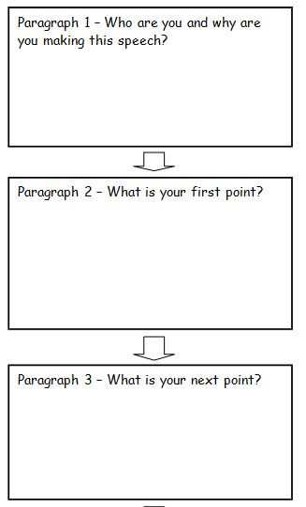
apply for the job of Master Builder
Can save Lego City
Citizens should choose me
Creative – don’t follow crowd
Hardworking
Lots of ideas
Emmet is not creative
Experience
Building – LEGO building experience
Experience saving a city – done it before

Slide 11
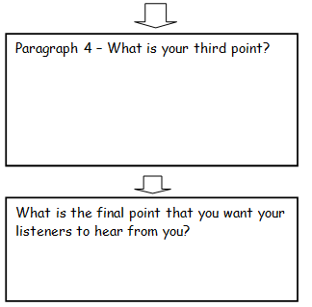
Perseverance
Resilience
Give examples like building furniture in home
Rhetorical Question
Emotions – poor helpless citizens.
Repetition phrase

